Slide 1
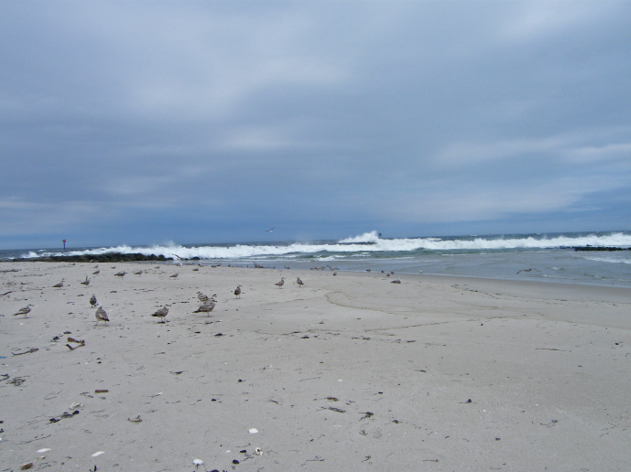
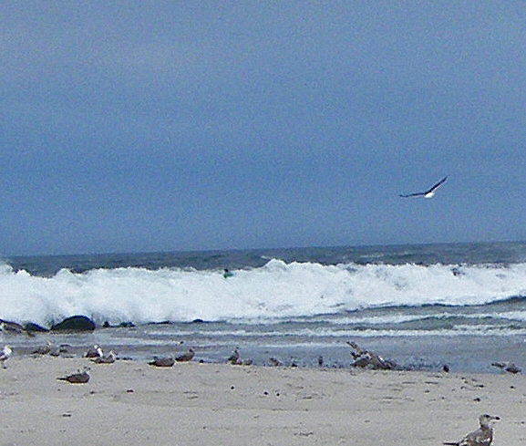
East Coast Tsunami of June 13, 2013 Contributors: Bill Knight, Dailin Wang, Yoo Yin Kim, Paul Whitmore, Kara Sterling NOAA/NWS TWCs July, 2013

Slide 2
Was it a meteotsunami?
Well, what is a meteotsunami (MT)?
Atmospherically forced waves in the tsunami frequency band.
Recent research shows the source mechanism is often directly attributed to abrupt air pressure jumps.
Pressure jumps of a few mbar translate to a sea level perturbation of a few cm (inverted barometer (IB) effect).
Resonance effects can greatly magnify the direct source effect.
High frequency jumps are necessary to impart tsunami frequencies.

Slide 3
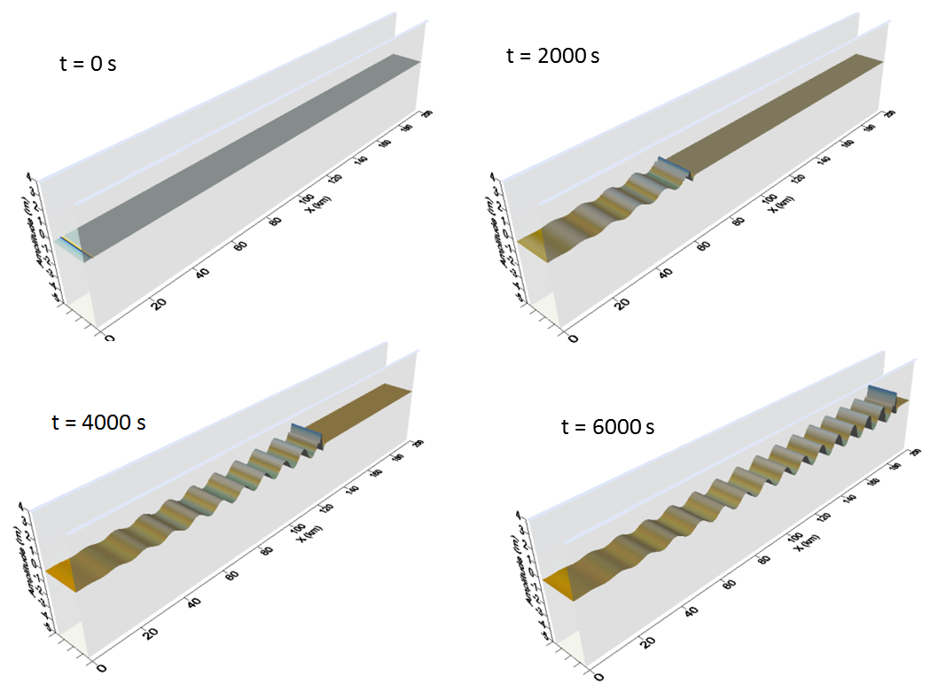
Resonance Effects
Proudman
Pressure jump propagation speed = long wave speed
Greenspan
Apparent along shore pressure jump prop. speed = edge wave speed
Proudman resonance simulation example for a one-dimensional case. In this example, the sine-wave disturbance propagates left to right at 30 m/s starting at t=0 and magnifies over 10x.

Slide 4
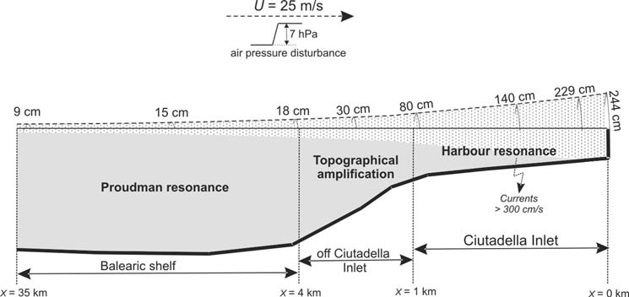
Resonance Effects
MT buildup example – Balearic Is.
From: Vilibic, et al., 2008

Slide 5
Has there been any east coast meteotsunamis?
NOAA MT project studied this
Yes - group published several papers on previous events
June, 2013 paper showed many events analogous to this one
That is, pressure jumps followed hours later by coastal tsunami impact (small in previous cases).
Cause of time delay determined to be due to shelf edge reflections.

Slide 6
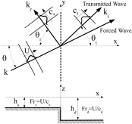
Shelf Edge Reflections
From Pasquet and Vilibic, 2013

Slide 7
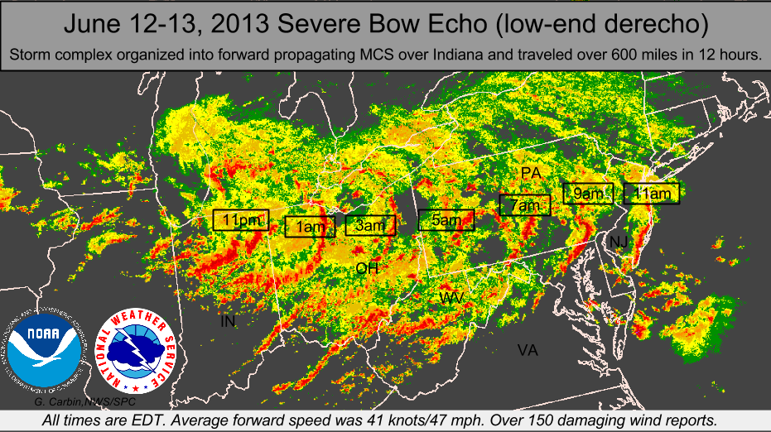
June 13, 2013 event
Background – major weather event moving across US rapidly

Slide 8
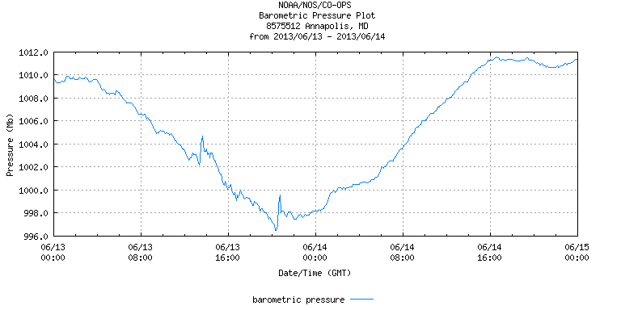
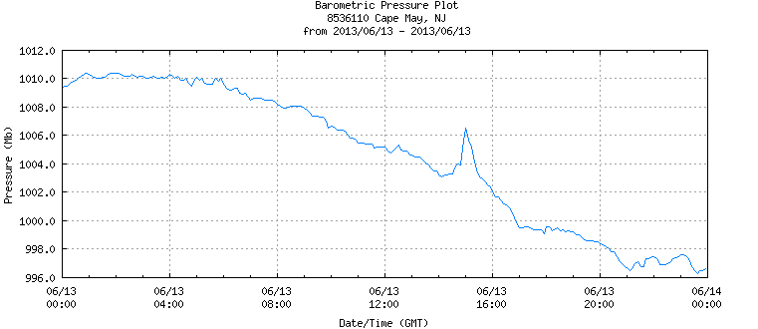
June 13, 2013 event
Pressure jumps noted in upper Chesapeake Bay and Delaware Bay at about 1300Z and 1500Z respectively (coincident with derecho passage)
Annapolis , MD– June 13-14
Cape May, NJ June 13, 2013

Slide 9
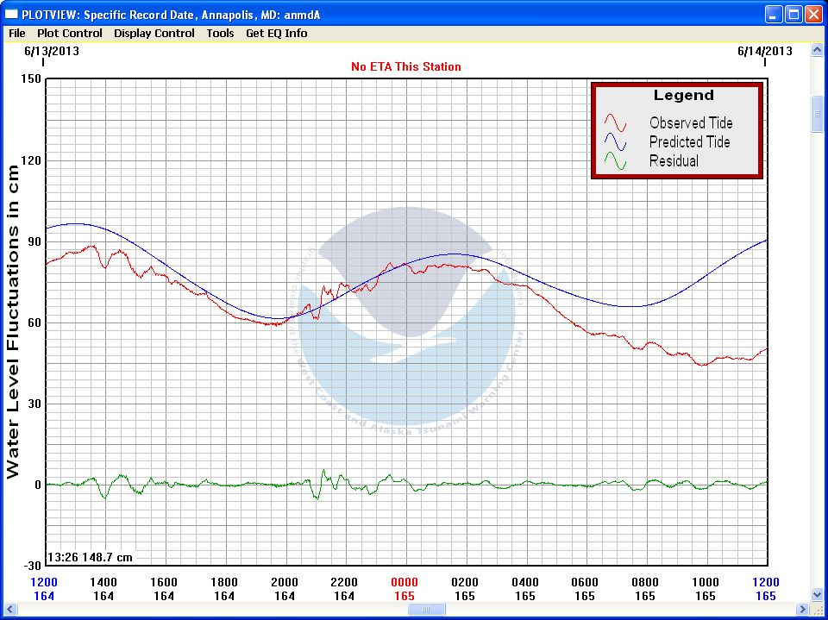
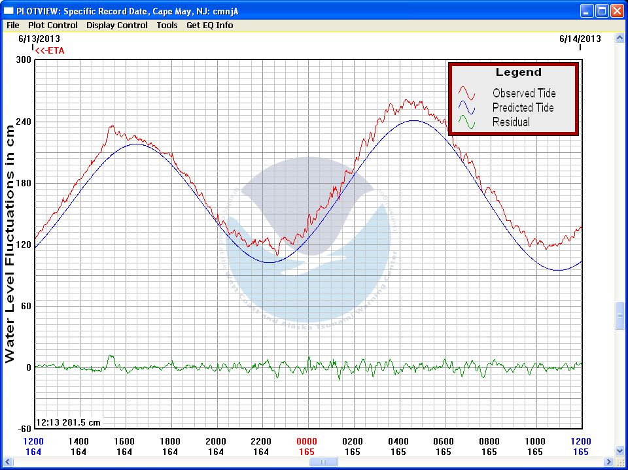
June 13, 2013 event
Sea level fluctuations at tsunami frequency noted to be coincident with pressure jump in those locations
Annapolis , MD– June 13-14
Cape May, NJ June 13,-14

Slide 10
June 13, 2013 event
Coincidence of sea level changes at tsunami frequency with air pressure jump passage indicates the jump is a possible MT source.
It is postulated that the system moved off shore at the correct speed to generate Proudman resonance and thus a larger wave.
DART 44402 arrival time matches (~1700Z).
A shelf edge reflection as determined by Pasquet and Vilibic provides rationale for the delay in the larger impacts back along the coast.

Slide 11
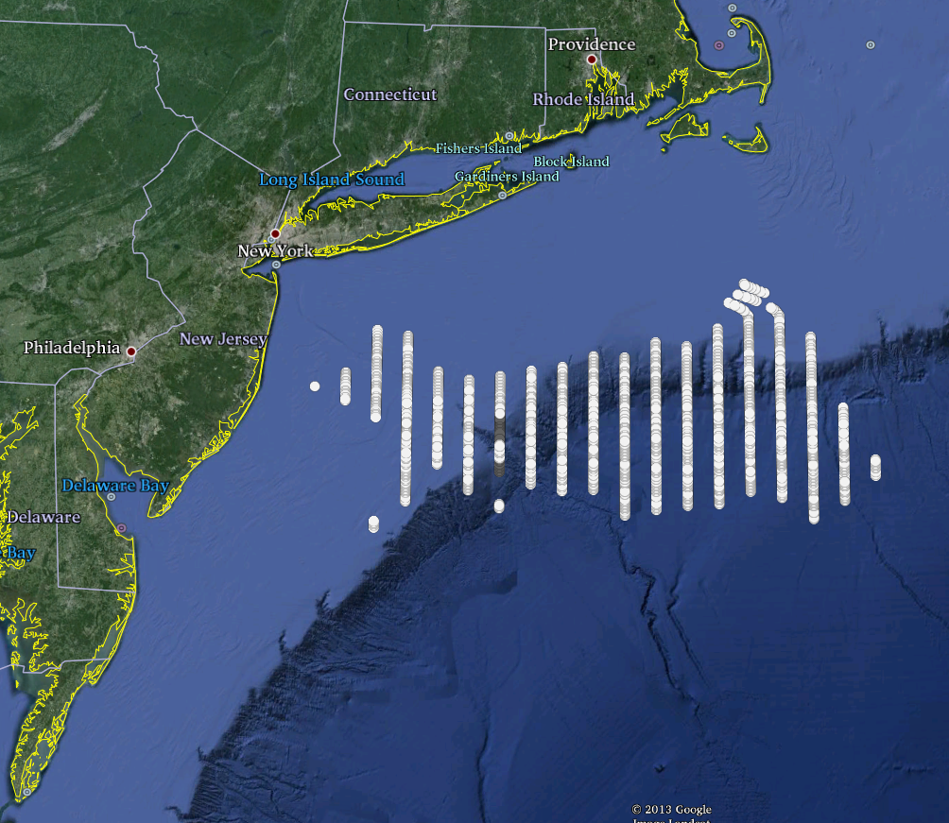
June 13, 2013 event
Analysis of arrival times (Wang)
White dots show source locations which have higher probability to generate observed arrival times.
Lends support for shelf break reflection as source

Slide 12
June 13, 2013 event
Can we reproduce the event numerically?
Simplified source:
Numerical model using 4.5mb jump.
Moving east at 20m/s (45 mph)
Source extends from 38N-40N

Slide 13
June 13, 2013 event
Alaska Tsunami Forecast Model adapted to use pressure field as source.
Coastal grid 15s increment; ocean grid 4’ increment
Animation by Knight shows strong reflection of shelf break. THIS ONLY SHOWS COASTAL GRID>
Results match well in time but not frequency. Modeled height is consistently high.
Suggests we need tighter, more transient source.

Slide 15
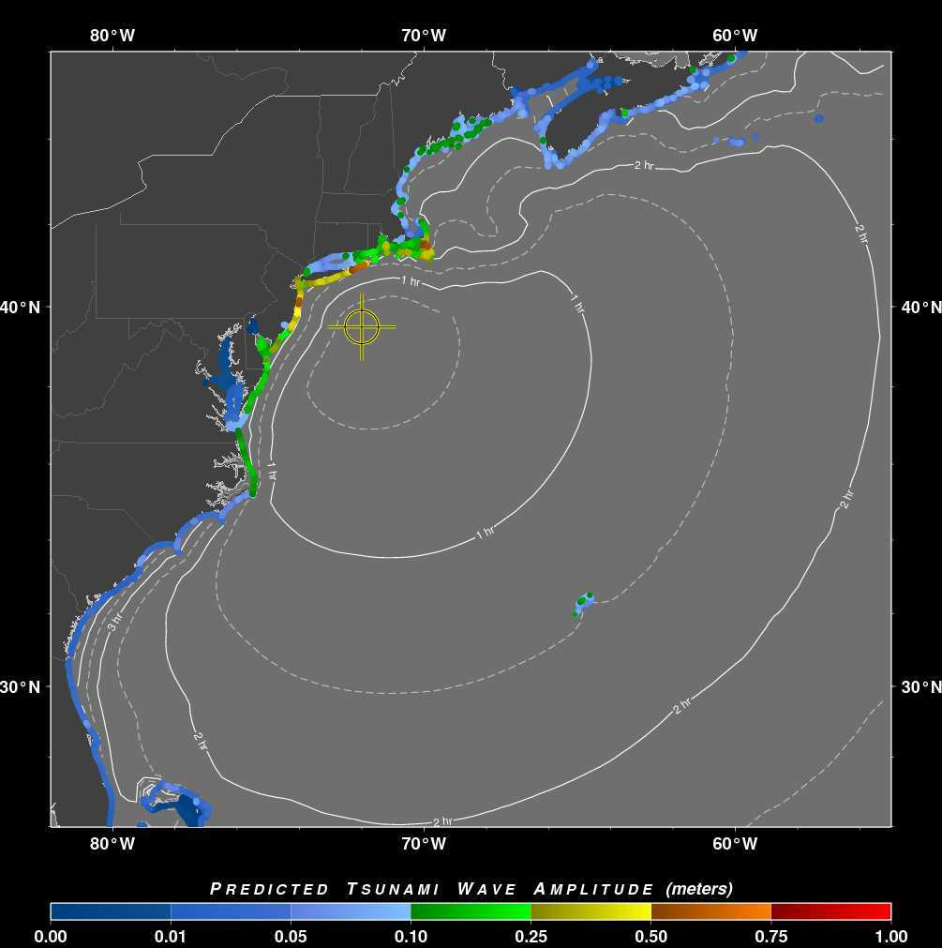
June 13, 2013 event
Results from PTWC RIFT model adapted for meteo source (Wang)
Uses two point source to attempt to simulate line

Slide 16
Next Steps
Need more atmospheric expertise to help refine source for ATFM/RIFT
Can atmospheric models reproduce the high frequency pressure jump?
Use a coupled model (atmospheric/oceanic)?

