Slide 1
Stratification on the Eastern Bering Sea Shelf, Revisited
C. Ladd¹, G. Hunt², F. Mueter³,
C. Mordy², and P. Stabeno¹
¹Pacific Marine Environmental Laboratory, Seattle, WA
²University of Washington, Seattle, WA
³University of Alaska, Fairbanks
Support from NOAA/NPCREP, NPRB and NSF

Slide 2
Motivation
Stratification associated with changes in zooplankton community (Coyle, et al. 2008)
  Weak stratification (1999): large zooplankton;
  Strong stratification (2004): small zooplankton
Summer productivity negatively influenced by high stratification (Sambrotto, et al. 2008; Strom and Fredrickson, 2008)
Stronger stratification (2004) associated with nutrient limitation, reduced microzooplankton grazing, and weak trophic coupling (Strom and Fredrickson, 2008)

Slide 3
Stratification Index
Potential energy relative to the mixed state (J/m²) can be used as an index of stratification (Simpson et al.,1978):
For a vertically mixed system, SI = 0; while SI becomes increasingly positive for increasingly stable stratification.
;
Notes:
Depth integrated measure. Ideally, the depth of the stratification is important too. Thus the Stratification Index along with a measure of Mixed Layer Depth

Slide 4
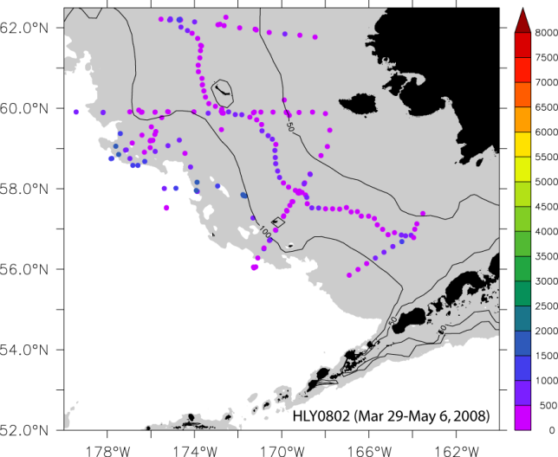
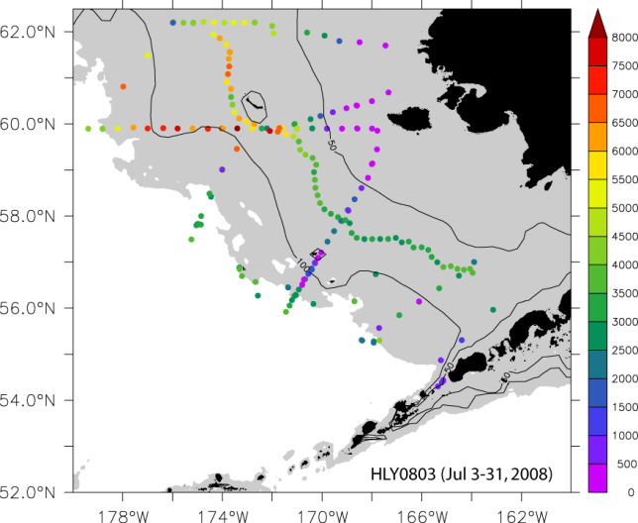
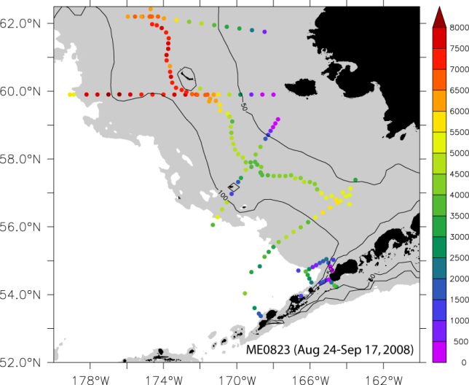
Strength of Stratification in 2008
Early
Spring
Late
Summer
Summer
Notes:
M2 and M4 are both in southern middle shelf region where temperature has dominant effect on summer stratification.

Slide 5
70m isobath transect
Inner
middle
Mooring 2
outer

Slide 6
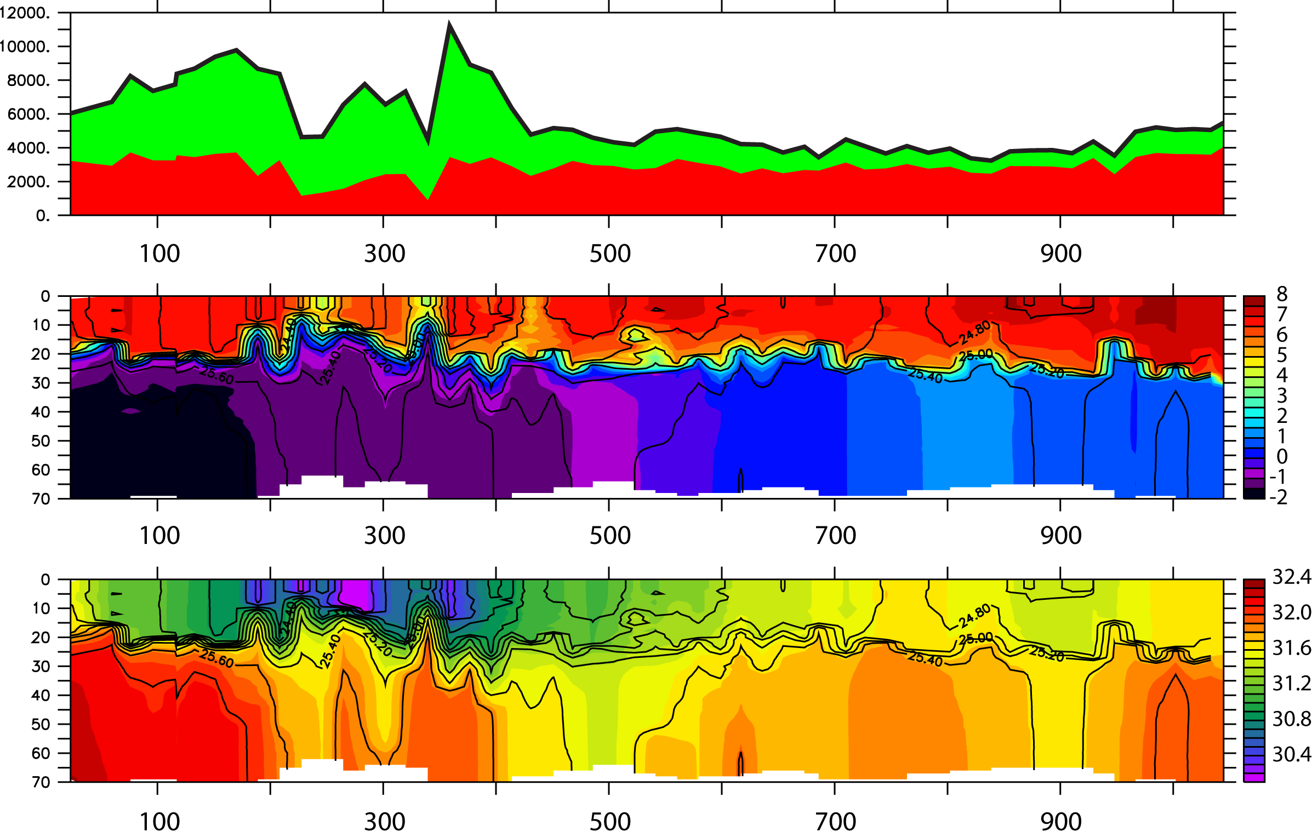
70m Isobath Transect
(summer 2008)
North
South
2-Layer structure
Stratification stronger in North
Salinity stratification dominates in North/ temperature dominates in South
Stratification Index
Due to Salinity
Due to temperature
Temperature (color); density (black contours)
Salinity (color); density (black contours)
Distance (km)

Slide 7
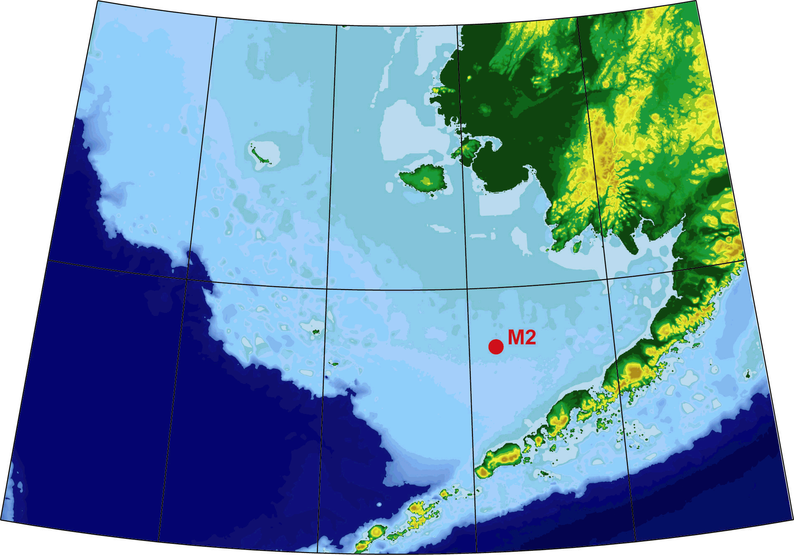
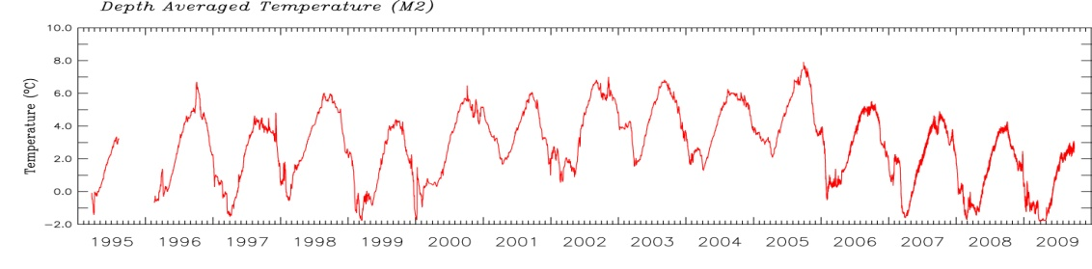
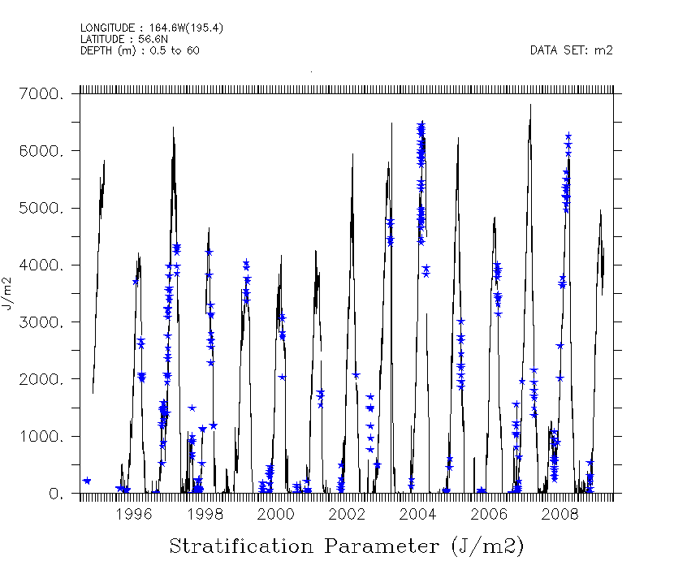
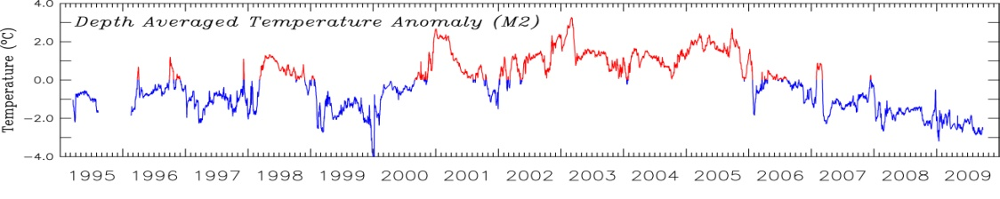
M2 Temperature vs. Stratification
Depth-Integrated Temperature
Anomaly
Cold
CTD data (blue stars) confirm that stratification calculated from M2 is good
Lower stratification before 2002 (other than 1997)
High/low stratification years do not align with warm/cold years
Warm
Notes:
Black line: stratification parameter calculated from Mooring 2 data. Blue stars are stratification parameter calculated from CTD data within 0.5 degree of M2. Both are integrated over 0:60m depth.
For mooring data, used linear interpolation between instruments and extrapolated from shallowest instrument to surface.
CTD data has much higher vertical resolution but matches that calculated from mooring pretty well suggesting that the vertical stratification at M2 is pretty well resolved by the instruments that were deployed.
Max summer stratification substantially stronger after 2002.

Slide 8
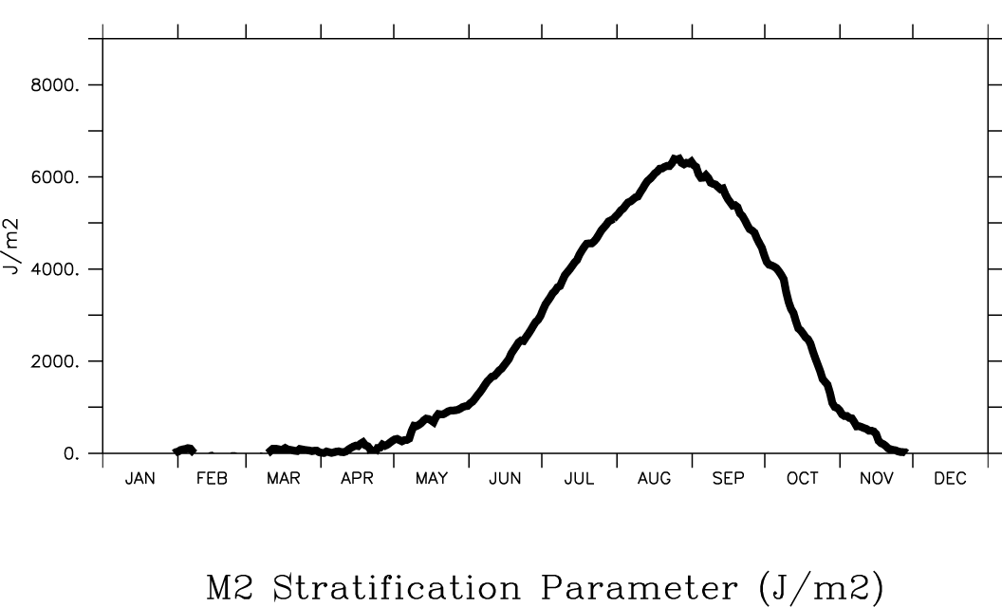
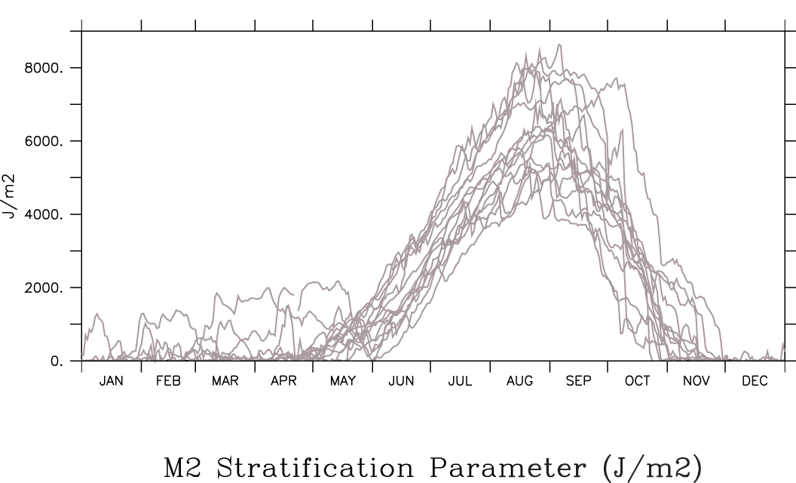
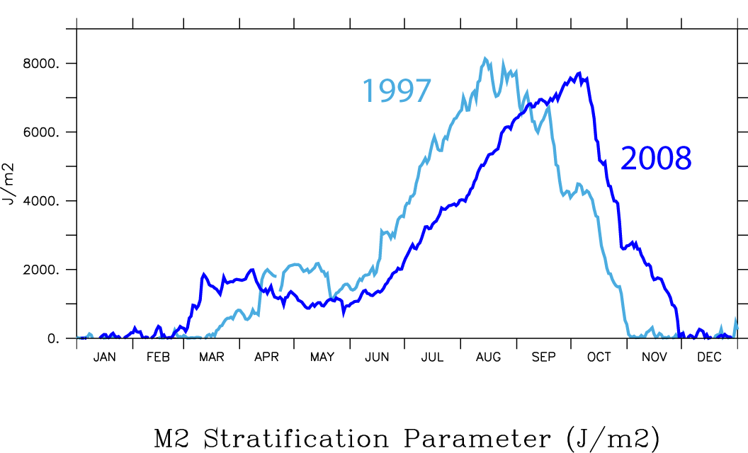
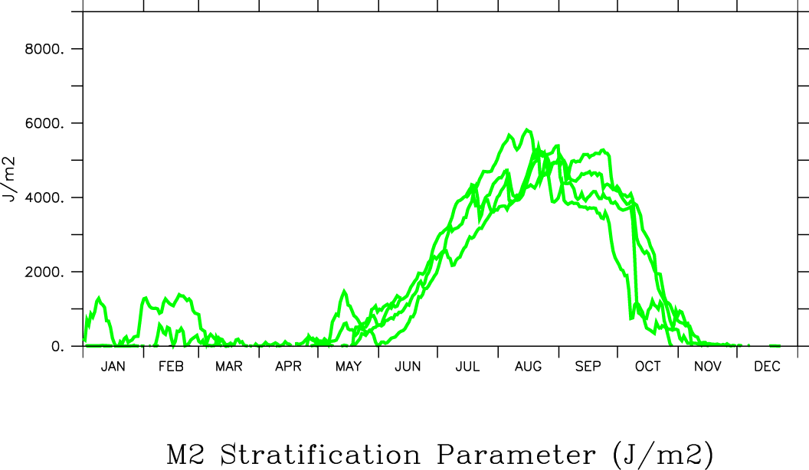
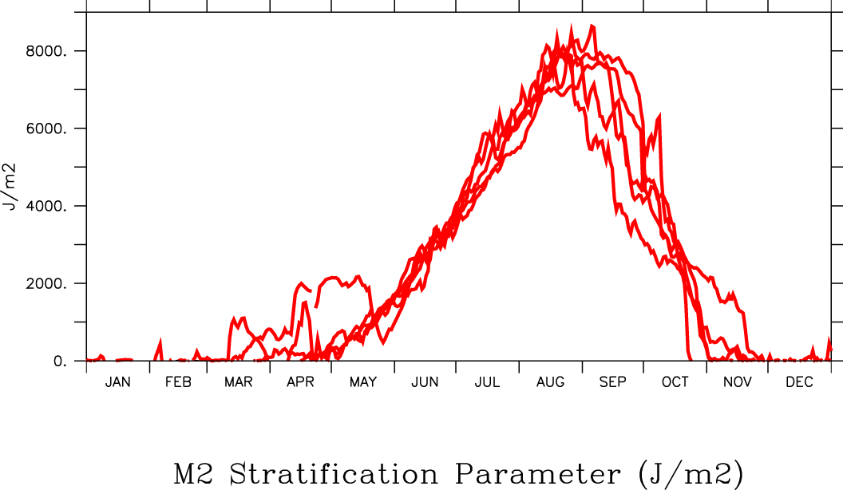
Seasonal Cycle
1997, 2003-2005, 2007
1998-2001
Notes:
Seasonal cycle – stratification starts to set up in Apr/May, maximum in late August, starts to break down in Sept
Any stratification prior to April is due to ice.
Lots of variability
Series of years with high or low max summer stratification
Also variability in timing of set up and break down
1997 was touted as highest stratification until mid 2000s. More recent high strat years, max strat is later in year than in 1997.
Especiall 2008 when max strat occurred in Oct

Slide 9
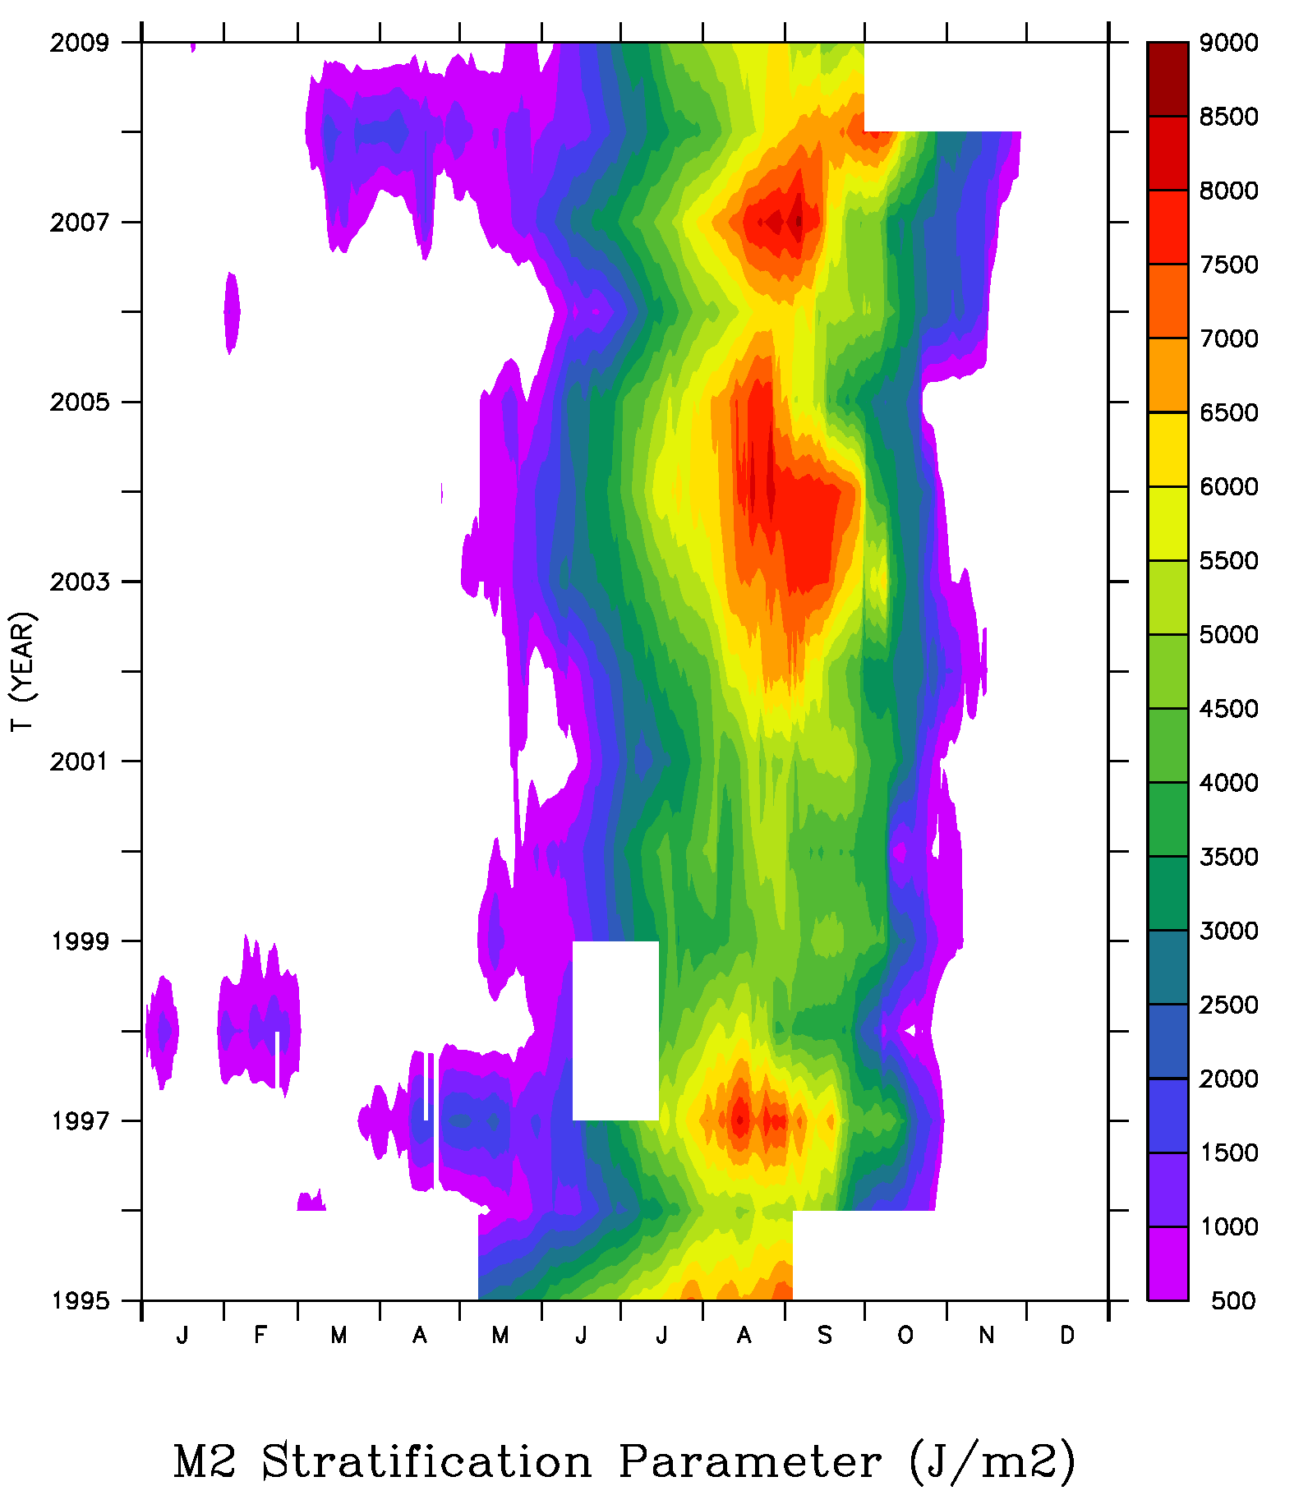
Seasonal and interannual variability
Significant trend toward later stratification breakdown in the fall (2.5 days later per year)
Stronger max stratification after 2002 (marginally significant)

Slide 10
Stratification vs. Pollock recruitment
Hypothesis:
Strong stratification
Low surface layer nutrients
Lack of large zooplankton
Reduced prey for
age-0 gadids
Low overwinter survival
Stock-recruit residual
R² =0.74
P < 0.001
95% CI
Stability index (J m⁻²)
(Computed from observations at Mooring 2)
Notes:
Stock recruit residual – is this pollock only???

Slide 11
Using proxy for Jul-Sep stratification at M2 from 1-D model
1963-2007
Relationship
breaks down
0.4
0.2
0.0
Stock-recruit residual
-0.2
-0.4
-0.6
R² =0.51
P = 0.008
95% CI
-0.8
3000
3500
4000
4500
5000
5500
Stability index (proxy)
Notes:
Blue circles are model 1995-2009??? , not as good a relationship as stabiltiy index from data. open is rest of years, relationship falls apart.

Slide 12
Conclusions
Interannual variability in stratification is not associated with warm vs. cold years (salinity stratification plays a role in interannual variability)
Salinity plays more of a role in stratification on the southeast middle shelf than originally thought
Winds, heat flux, tidal mixing all contribute to timing of spring stratification set-up
Wind mixing is primary determinant in timing of stratification break-down (modulated by stratification strength)
Stratification appears to influence pollock recruitment in recent 15 years of observations, but may not have strong influence over longer time period (influence of temperature on prey may be more important)

Slide 13
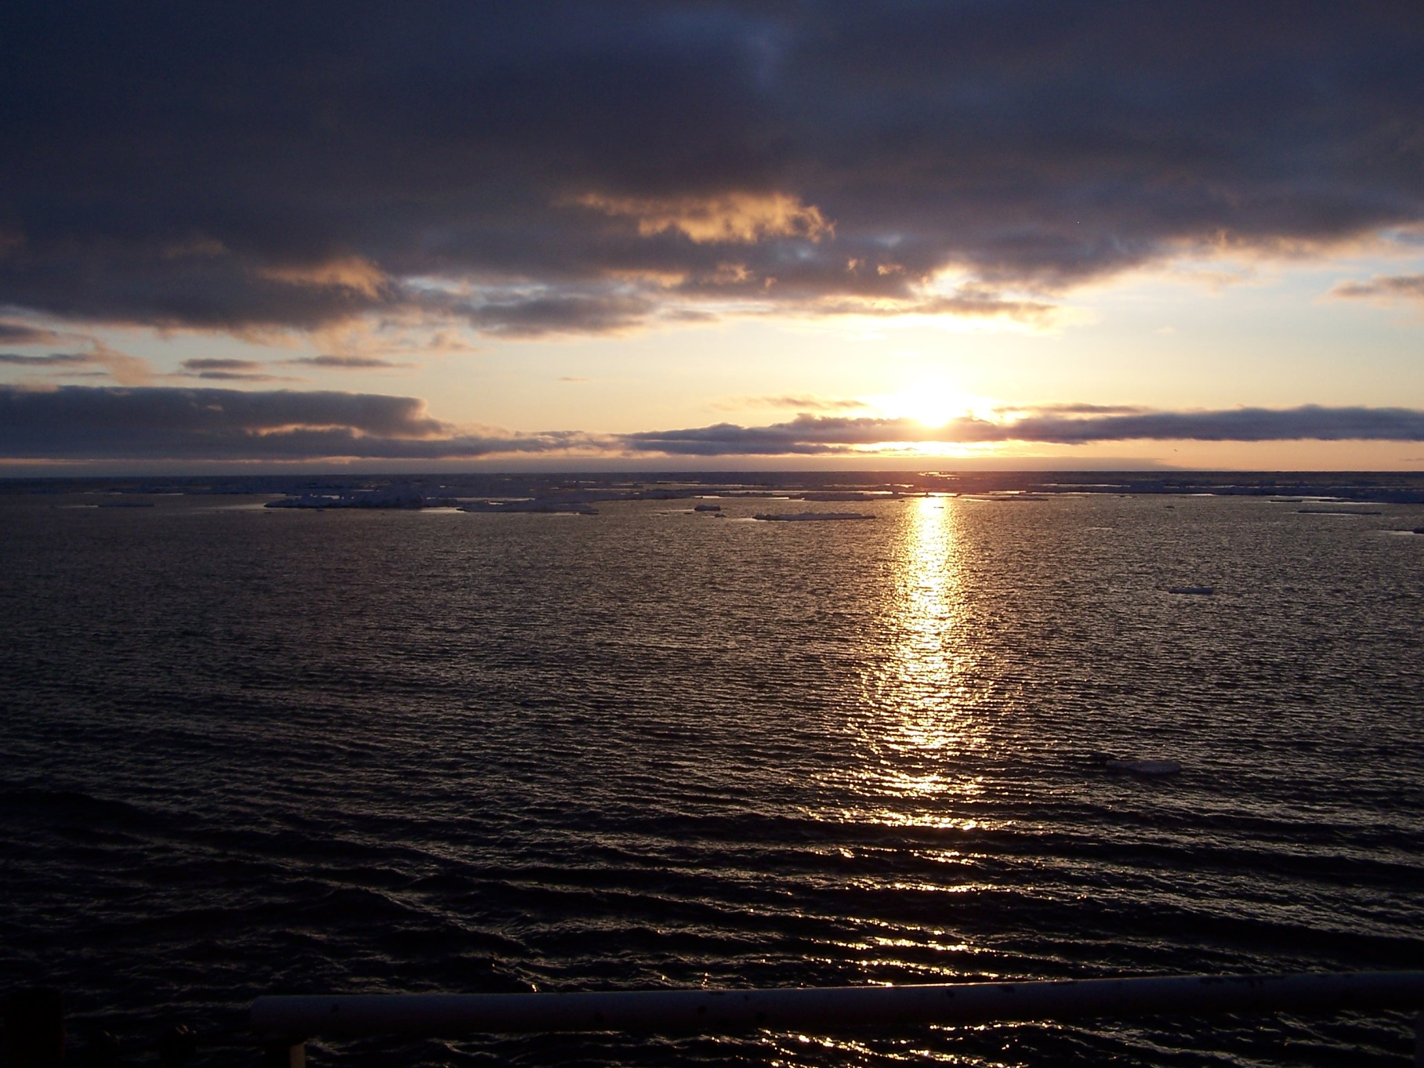
Thank you

Slide 14
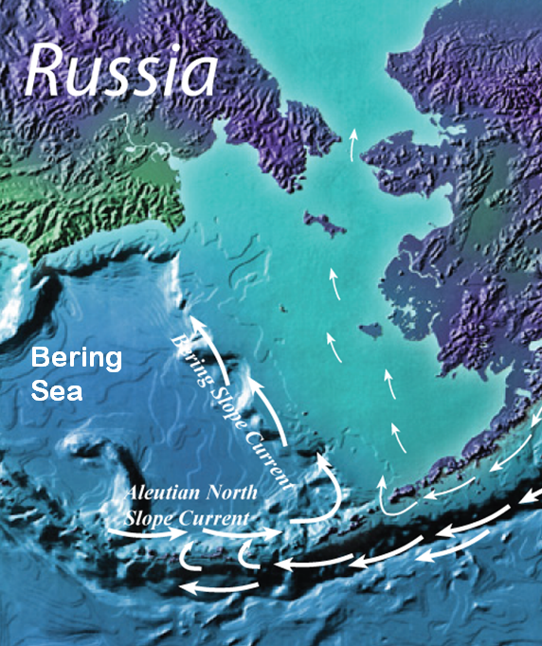

Bering Sea
Wide shelf (>500 km)
3 shelf domains (coastal, middle shelf, and outer shelf)
Marginal Ice zone
Sea ice, temperature, stratification important to ecosystem
⇒
Seasonal
Sea Ice
outer
inner
middle

Slide 15
1D Potential Energy Balance
= rate of heat input (NCEP)
= tidal current speed near bottom (M2 data)
= wind speed (NCEP)
Multiple regression analysis of 2005 data indicates that during the spring, heating, tidal currents, and winds are all important in predicting changes in stratification

Slide 16
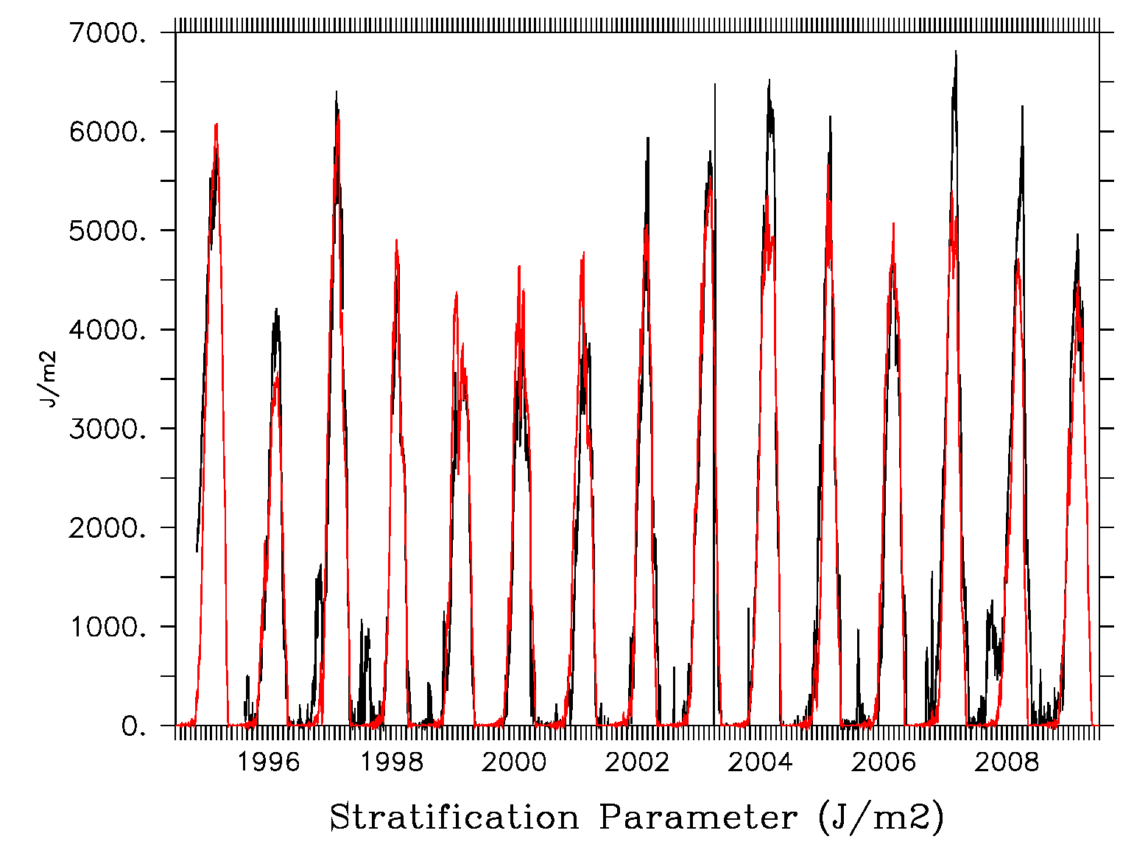
Data
Interannual variability in summer stratification
Correlations with heat flux, winds, tides not significant
But 1D model does a pretty good job (mean summer stratification index is significantly correlated)
  Implying that the day-to-day variations matter – can’t use seasonal averages
Model
Sharples 1D model (has been used in studies of the North Sea, e.g. Sharples et al, 2006)
Forced by tides, NCEP meteorology
  Tidal amplitudes calculated from M2
  January 1 temperature estimated from St Paul air temperatures

Slide 17
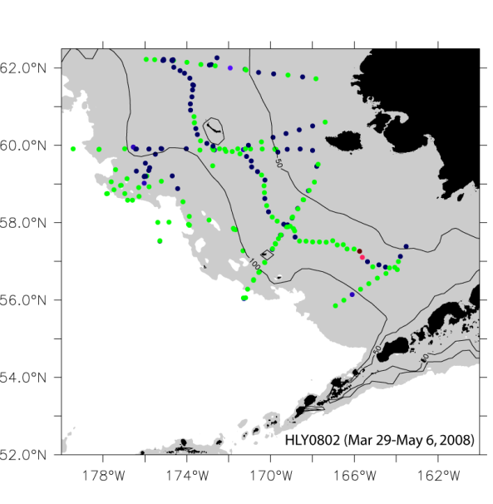
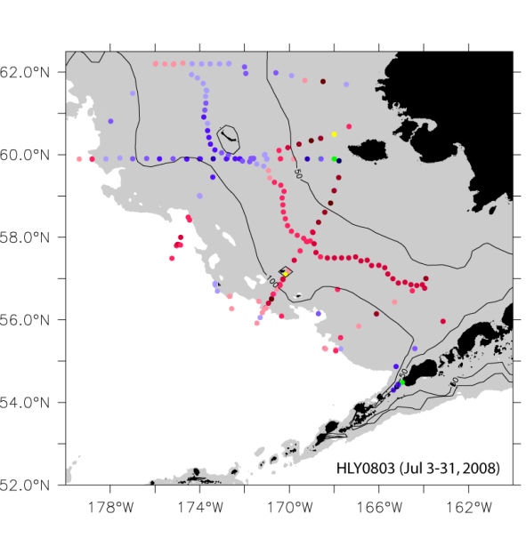
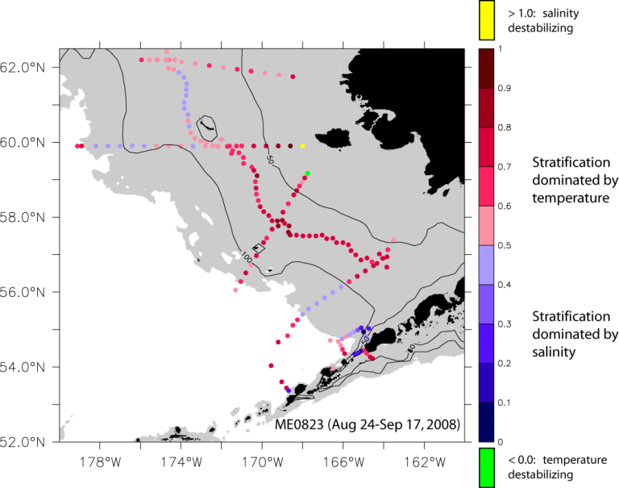
Strength of Stratification (calculated over top 60m)
Dominance of Temperature vs. Salinity
Early spring: stratification very weak, dominated by salinity (temperature effect mostly unstable)
Summer: stronger stratification in north (salinity), weaker in south (temperature)
Late summer: stratification has strengthened especially in north due to temperature, outer shelf strat dominated by salinity
Notes:
M2 and M4 are both in southern middle shelf region where temperature has dominant effect on summer stratification.

Slide 18
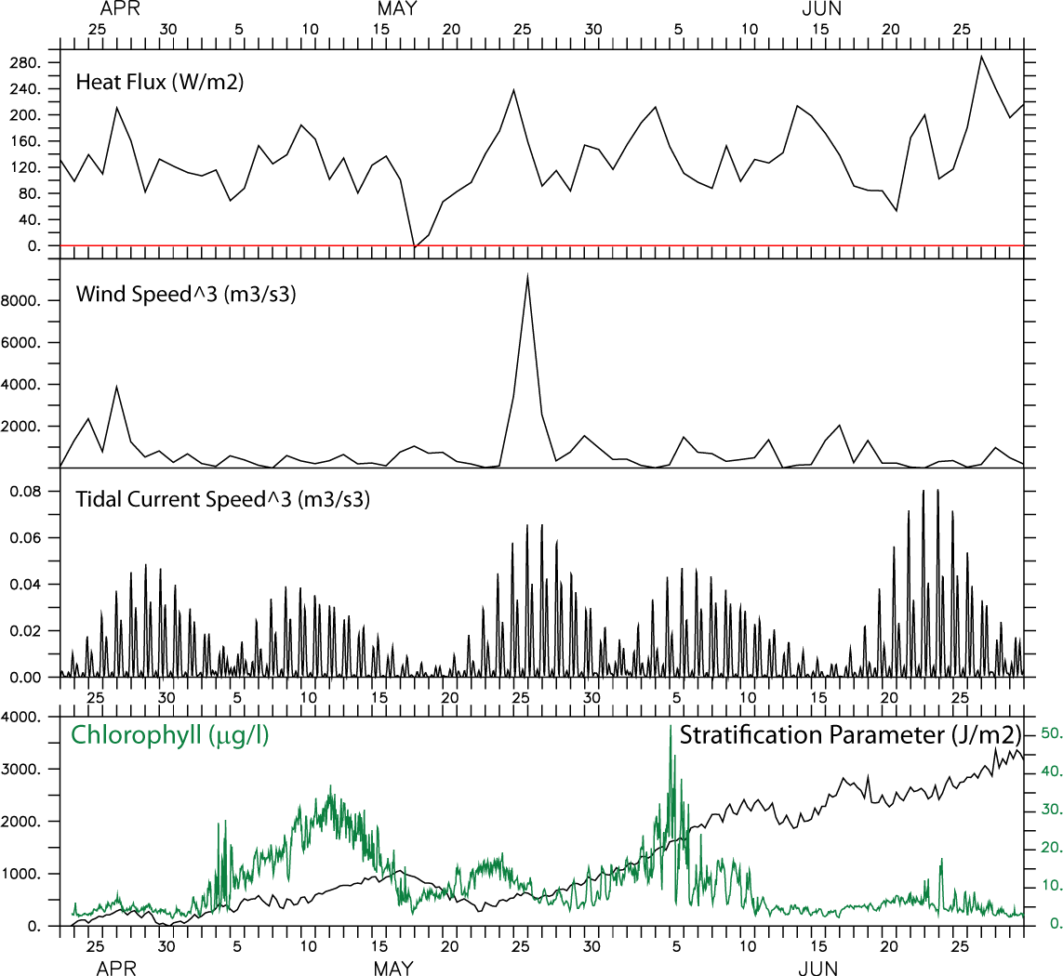
2005
Steady increase in stratification
positive heat flux
Low wind speeds
Low tidal currents
allows for incr. Chl
Spring bloom starts first week of May
Positive heat fluxes
Low wind speeds
Low tidal currents
Decrease in stratification
Low heat flux
Higher wind speeds
Results in new nuts
and incr. Chl

Slide 19
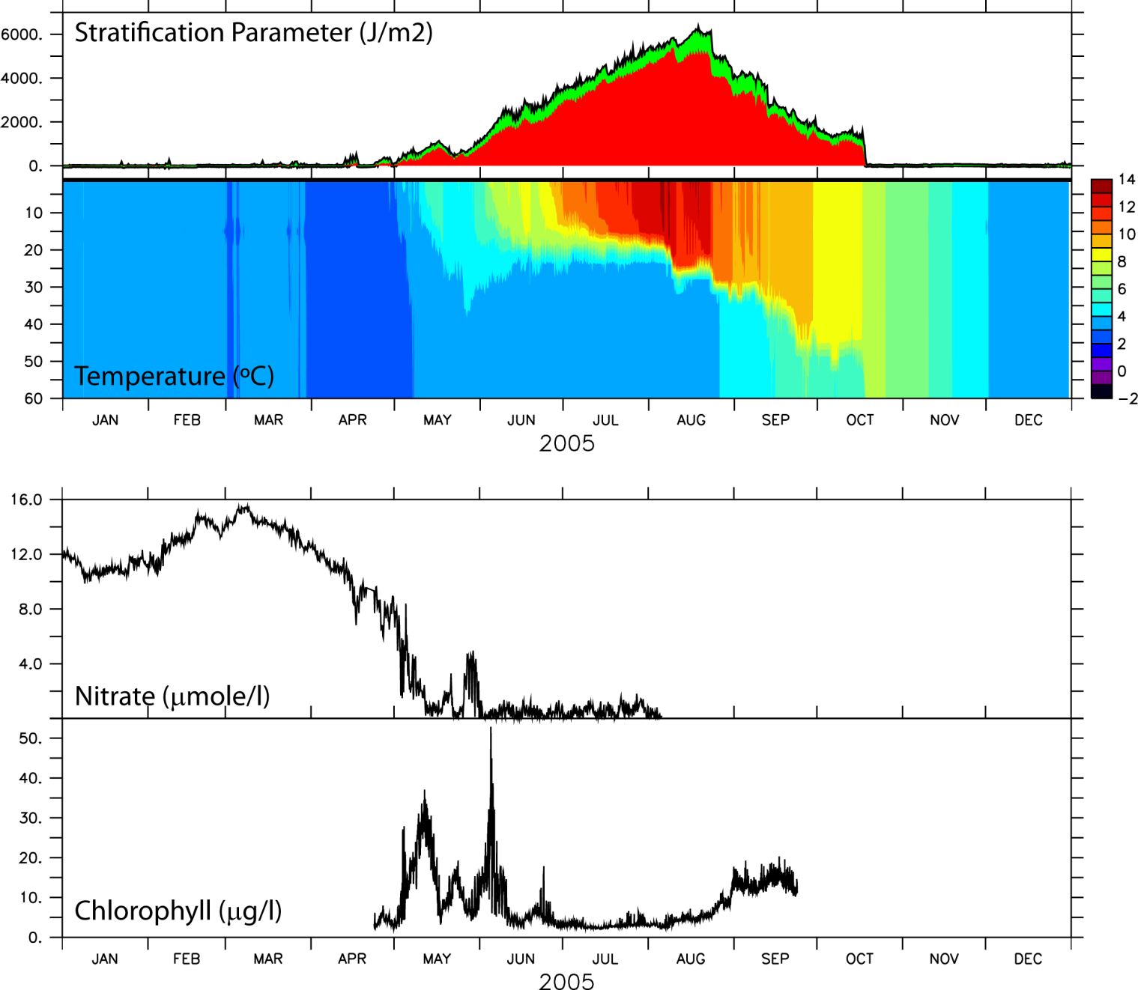
Mooring 2
(2005)
2-Layer structure
Stratification dominated by temperature but salinity has some influence
Max stratification in August; breakdown in October
Influence on nutrient and chlorophyll concentrations

