Slide 1
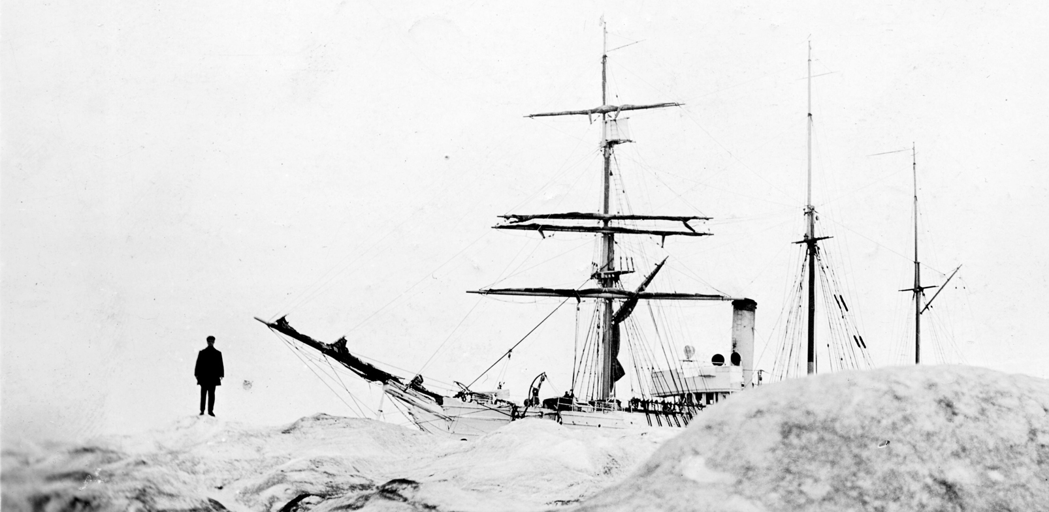

























Old Weather Arctic
LARGE-SCALE ENVIRONMENTAL DATA RESCUE THROUGH CROWDSOURCING
Kevin Wood
and
P. Brohan,
J. Overland,
E. Hope,
G. Smith,
N. Soreide,
M. Mollan,
L. Mishonova,
A. Smith,
and
20,000
Citizen-Scientists:

Slide 2
Why data rescue?
The changing Arctic climate is a harbinger of a global future, but to understand emerging patterns we need to know more about the past history of the Earth's weather
Currently available datasets are insufficient to the tasks at hand
Luckily, far more data exist (especially marine-met) than have been utilized so far – on the order of gazillions of observations
New technologies are transforming the way we recover and use large amounts of historical weather and environmental data
The real wayback machine:
CROWDSOURCING & REANALYSIS

Slide 3
Why data rescue?
The changing Arctic climate is a harbinger of a global future, but to understand emerging patterns we need to know more about the past history of the Earth's weather
Currently available datasets are insufficient to the tasks at hand
Luckily, far more data exist (especially marine-met) than have been utilized so far – on the order of gazillions of observations
New technologies are transforming the way we recover and use large amounts of historical weather and environmental data
The real wayback machine:
CROWDSOURCING & REANALYSIS

Slide 4
Why data rescue?
The changing Arctic climate is a harbinger of a global future, but to understand emerging patterns we need to know more about the past history of the Earth's weather
Currently available datasets are insufficient to the tasks at hand
Luckily, far more data exist (especially marine-met) than have been utilized so far – on the order of gazillions of observations
New technologies are transforming the way we recover and use large amounts of historical weather and environmental data
The real wayback machine:
CROWDSOURCING & REANALYSIS

Slide 5
Why data rescue?
The changing Arctic climate is a harbinger of a global future, but to understand emerging patterns we need to know more about the past history of the Earth's weather
Currently available datasets are insufficient to the tasks at hand
Luckily, far more data exist (especially marine-met) than have been utilized so far – on the order of gazillions of observations
New technologies are transforming the way we recover and use large amounts of historical weather and environmental data
The real wayback machine:
CROWDSOURCING & REANALYSIS

Slide 6
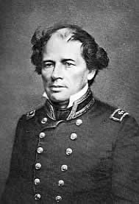
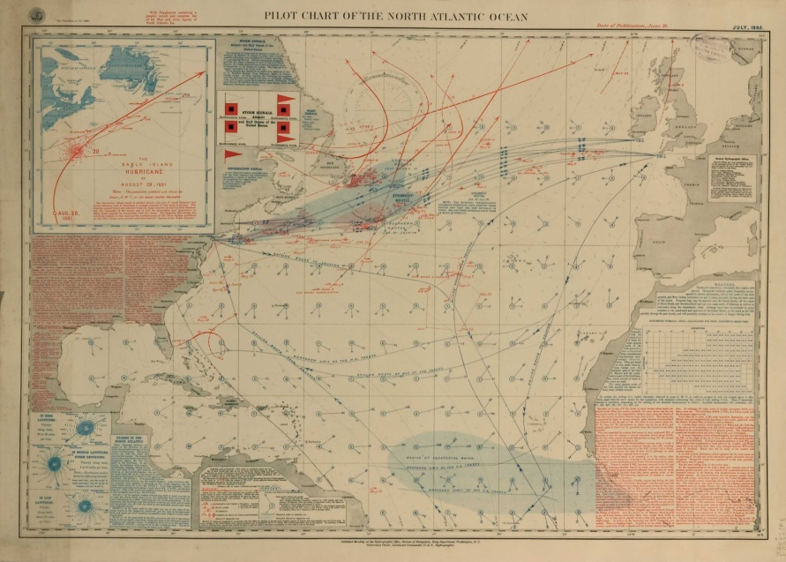
Large-scale patterns revealed
(by rescued data)
  1853
  Brussels Conference standardized the collection of marine-meteorological data needed for the construction of pilot charts for the world’s oceans
  Lt. Matthew Maury, US Navy
  (1806-1873)
  Pilot charts show typical marine wind and weather patterns

Slide 7
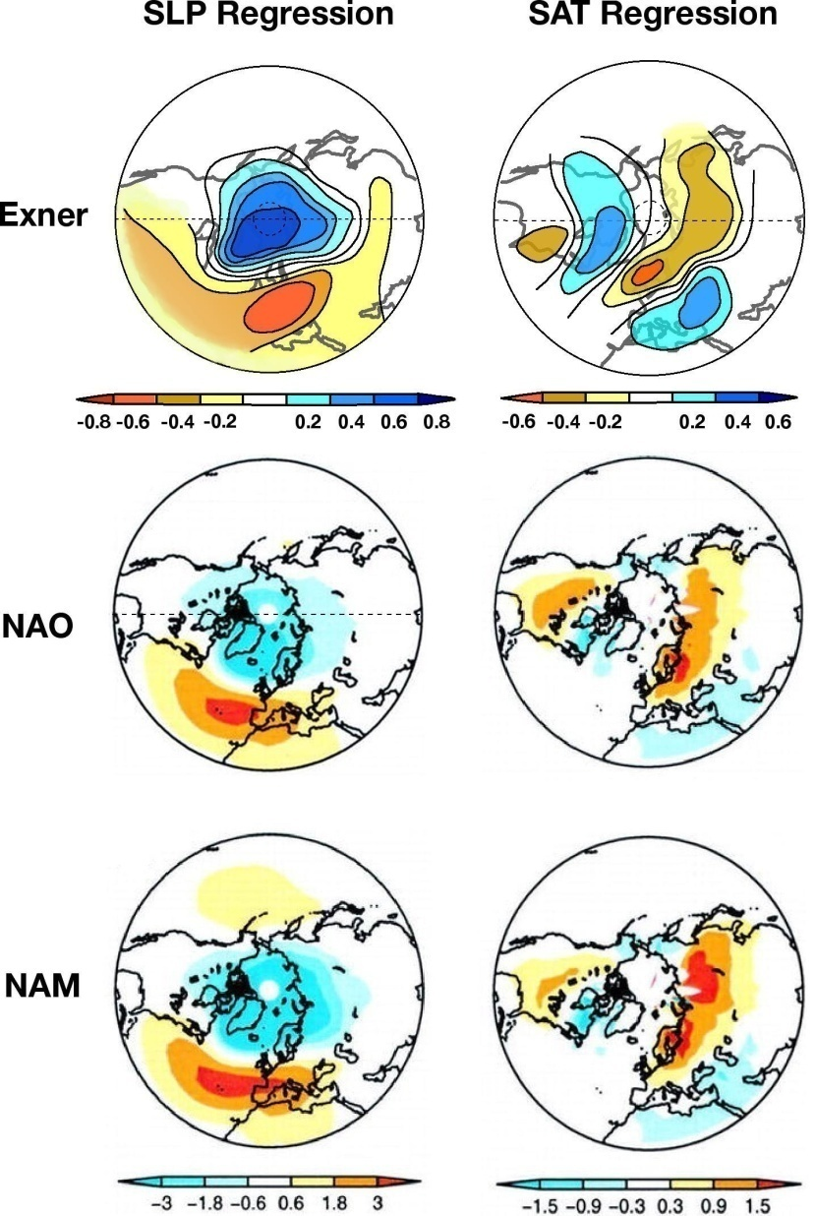
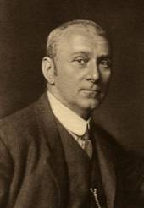
Large-scale patterns revealed
(by rescued data)
  1923
  Meteorological Conference organized first data rescue program that became World Weather Records published by the Smithsonian in 1927
  Foundation of basic climate data sets still used today:
    GHCN-D
    ISPD
    ICOADS
    GISS
    CRUTEM
    HadISST…
SLP
SAT
Exner
1913
F.M. Exner
(1876-1930)
Walker
NAO
AO
G.T. Walker
(1868-1958)
Adapted from F.M. Exner (1913) Über monatliche Witterunganomalien auf der Nördiche Erdhälfte im Winter; NAO & AO/NAM courtesy of J.M. Wallace

Slide 8
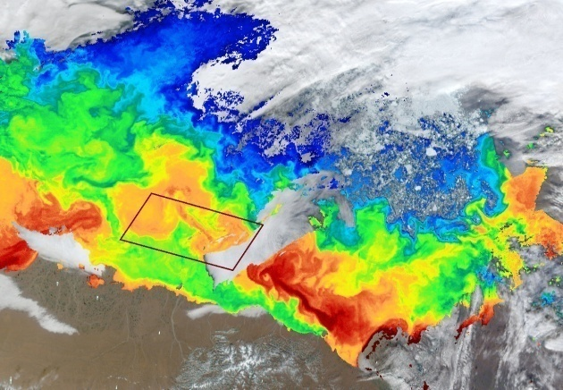
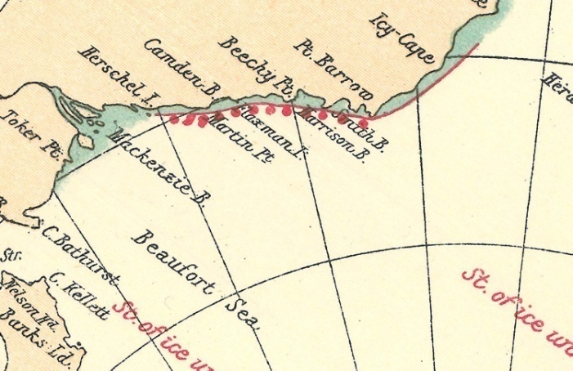
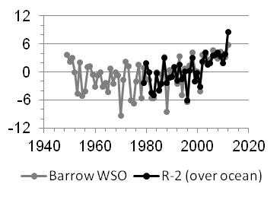
New needs, new demands
12-13 September 2011
SEA ICE
Context: has this _____ happened before?
Simple statistics → gridded data → reanalysis
Now need sub-daily(!) resolution data
Highest priority: pressure, SST & sea ice
ALASKA
Mackenzie Delta
°C
Sea Ice
Sea Ice
Sea Ice
August 1933
Surface T anomaly (October)
°C
‘New normal’ in the Beaufort Sea?
SST
°C

Slide 9
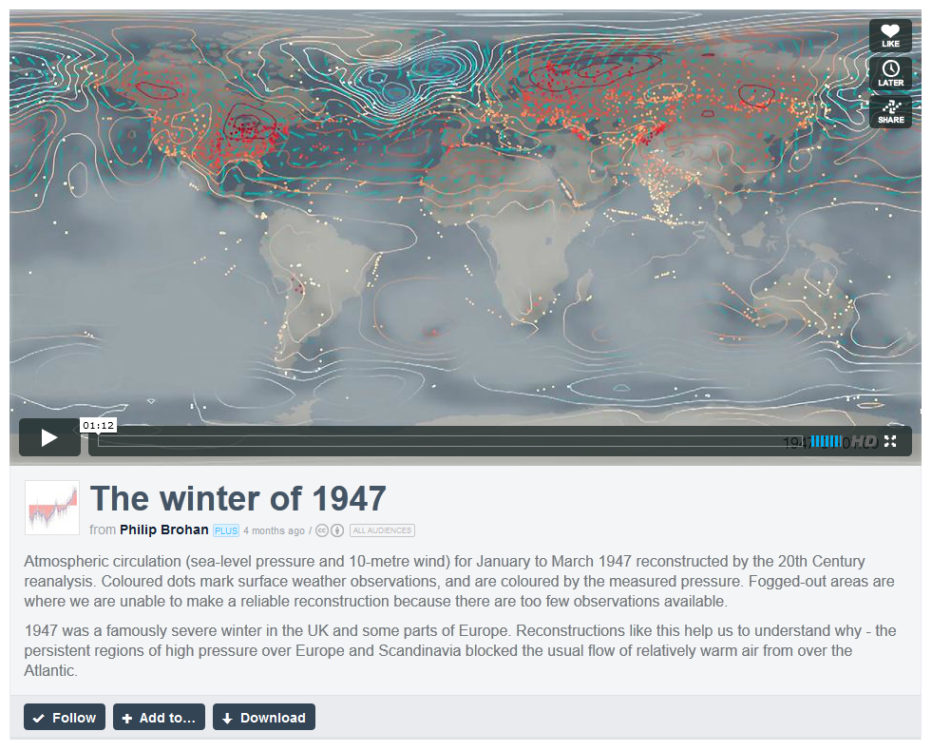
Extended reanalysis
Data assimilation system + old data → 6 hourly reconstruction (~1850 on)

Slide 10
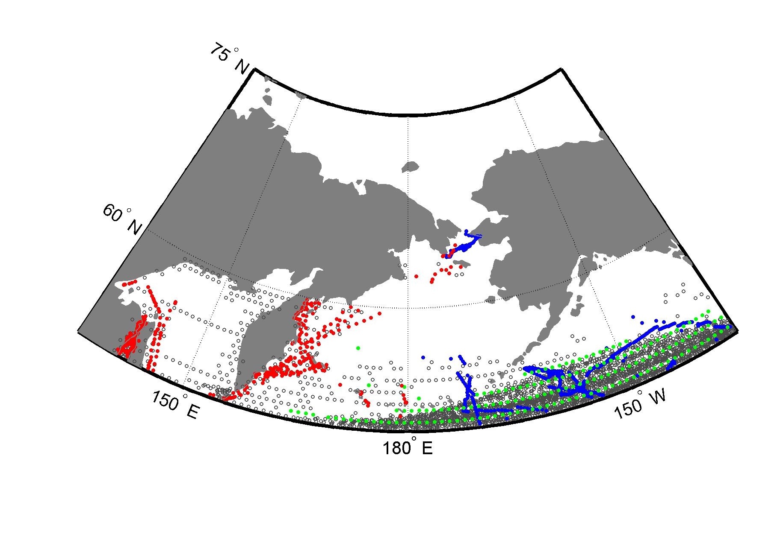
Where’s the data?
1880-1909
Russia
USA
Great Britain
Other / Unknown
RUSSIA
ALASKA
BERING SEA
ICOADS Individual Ship Reports – Each dot is a single measurement at time t
We know many ships were collecting hourly observations in this region…

Slide 11
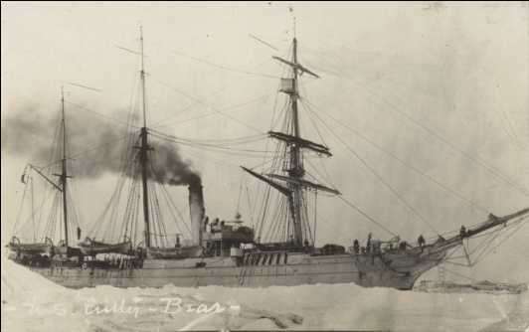
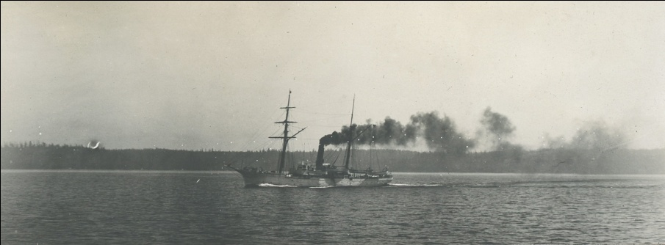
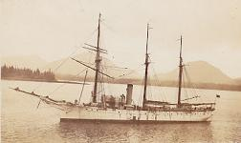
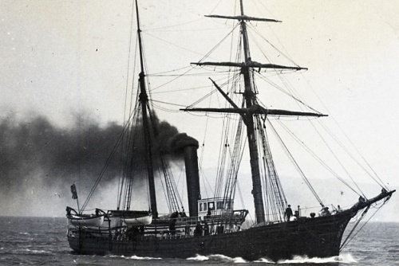
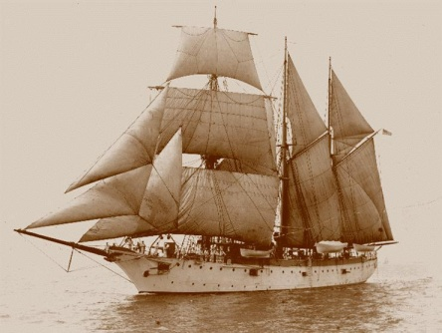
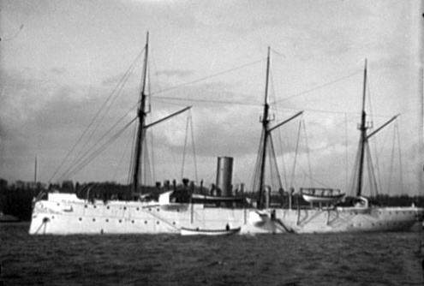
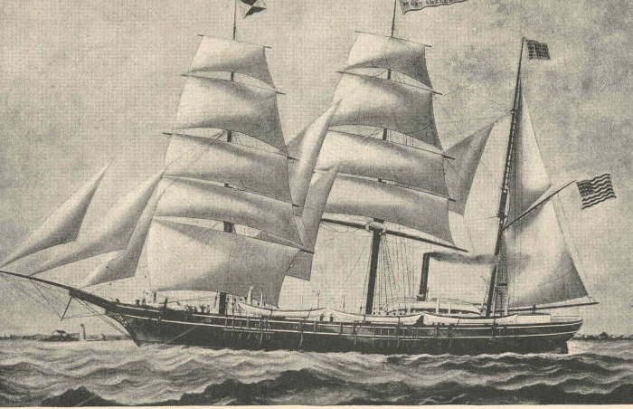
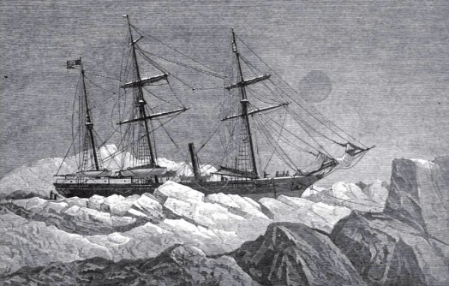
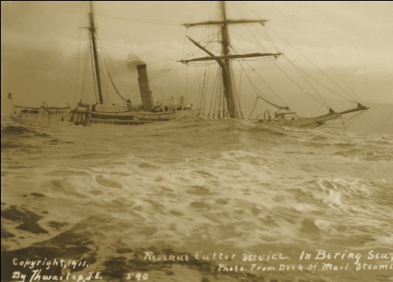
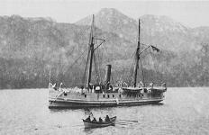
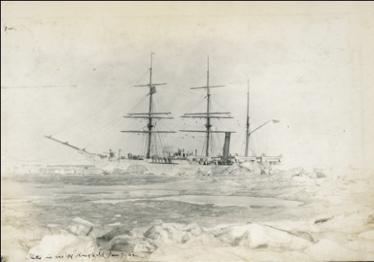
Ships like these…
USRC Bear USRC Perry USCS Patterson
USRC Corwin USS Vicksburg USS Yorktown USS Rodgers
USS Jeannette USRC Rush USS Pinta USRC Thetis

Slide 12
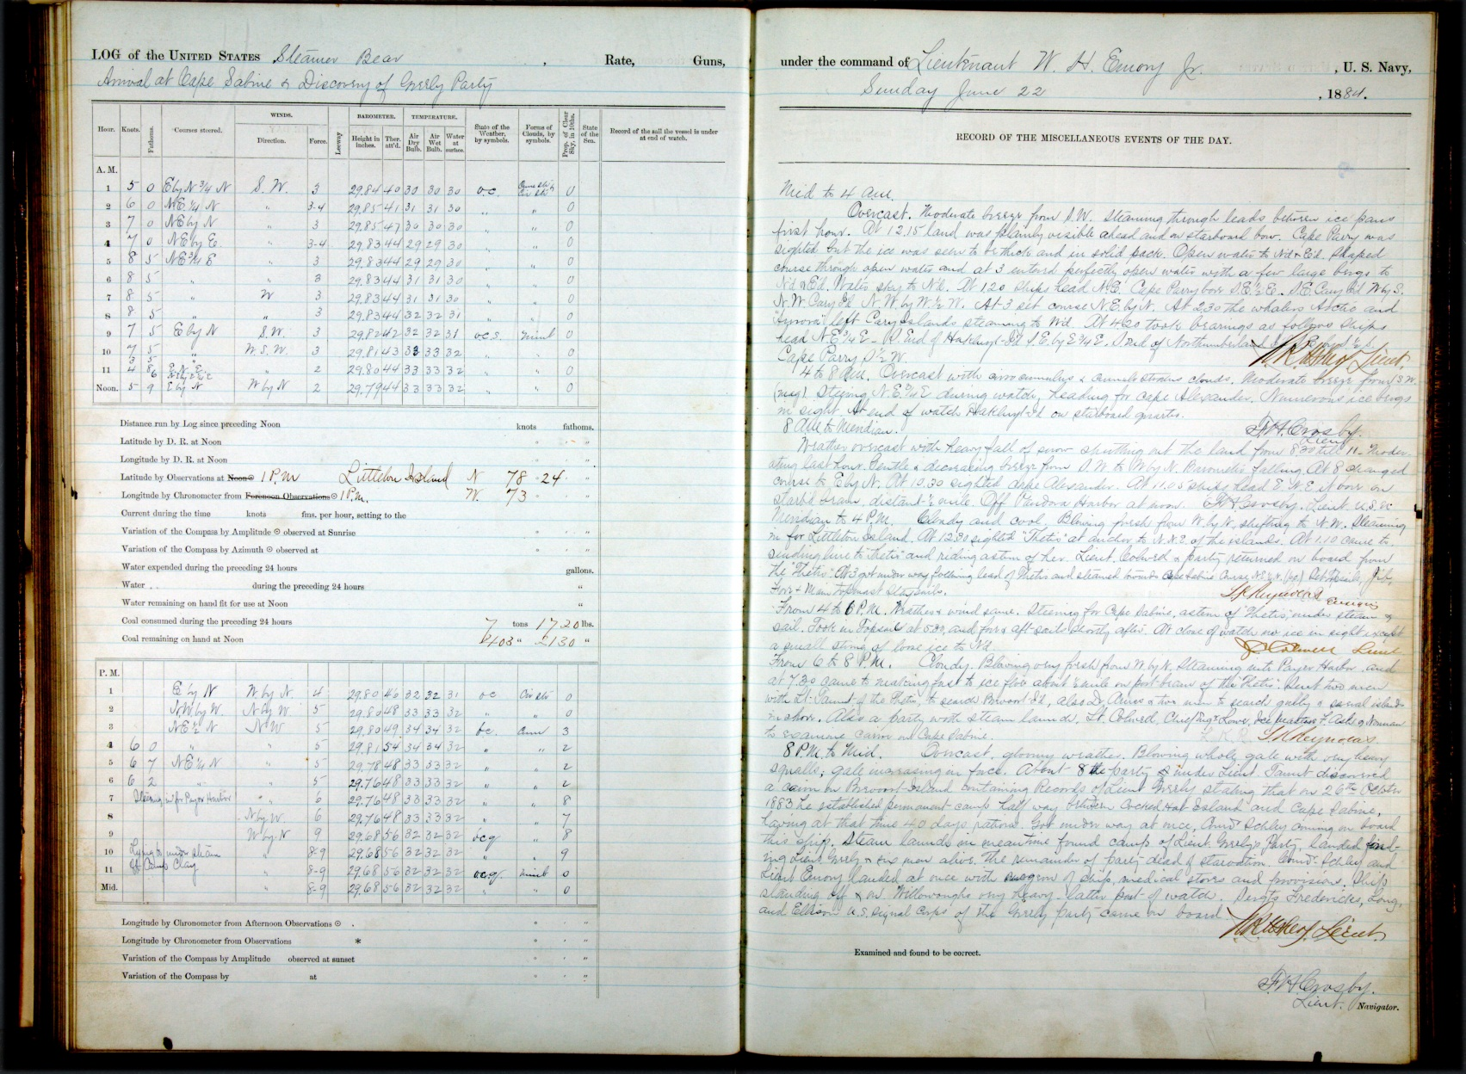
…collected tons of data

Slide 13
?
HOW
do
you
get
all those scribbles
DATA
turned
into

Slide 14
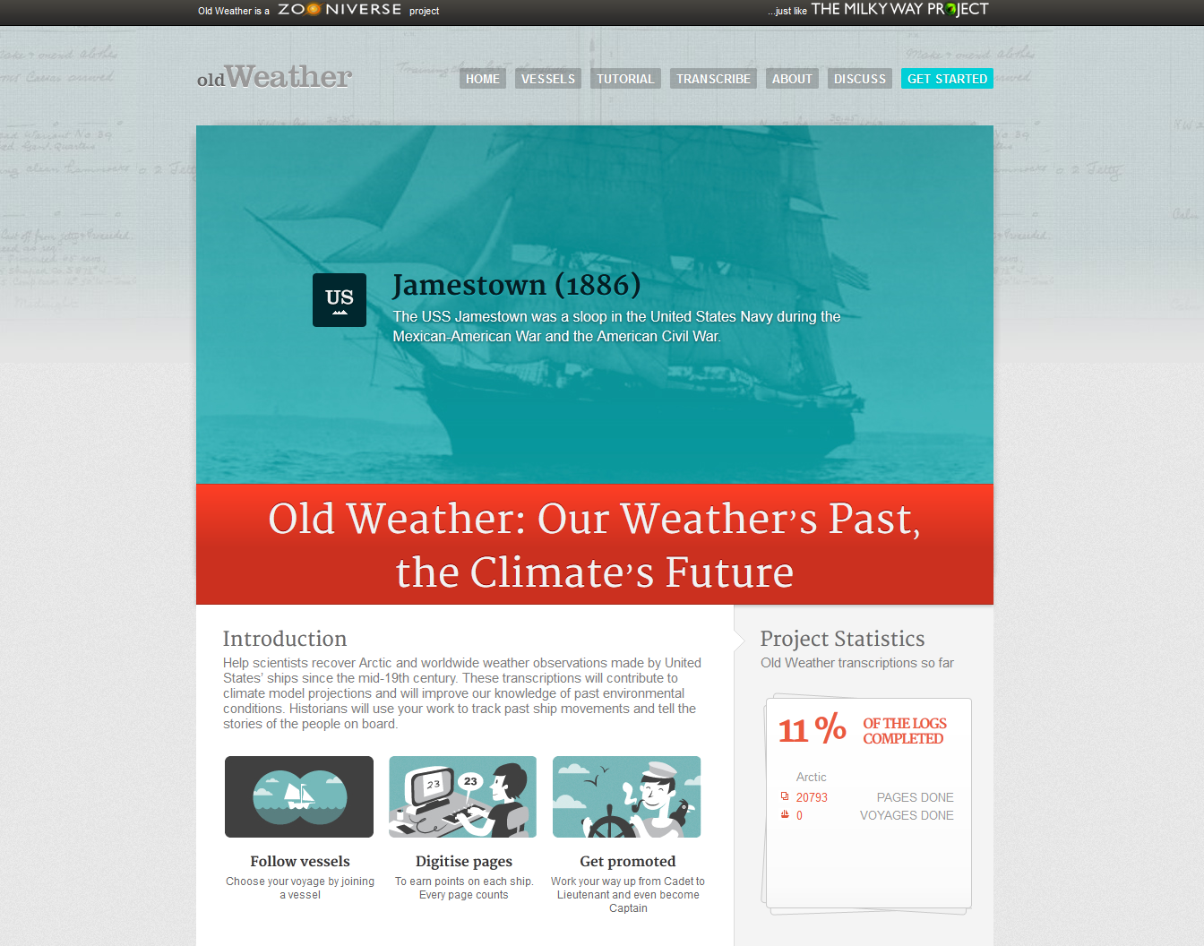
Old Weather + citizen-scientists
Getting the job done!

Slide 15
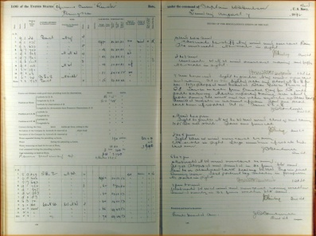
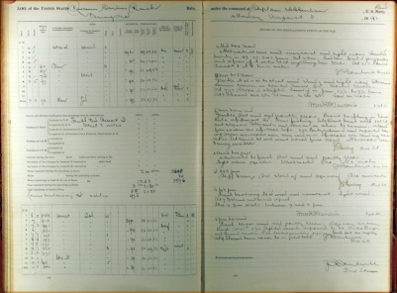
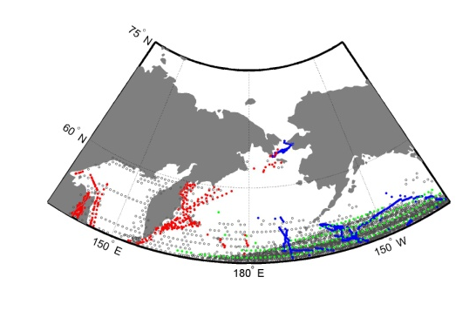
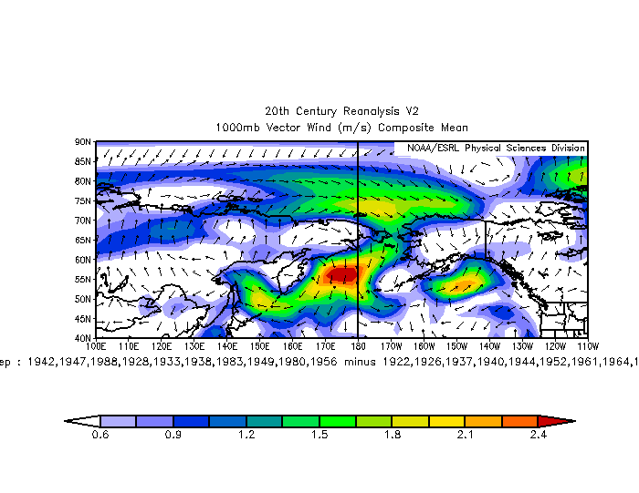
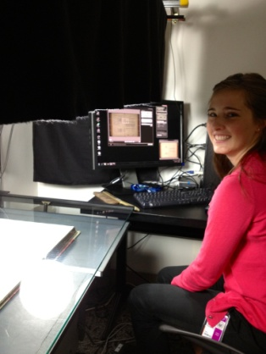
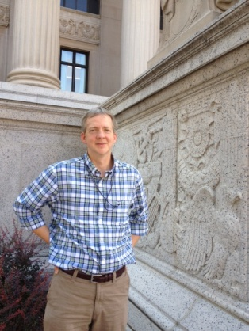

End-to-end data rescue
2
4
Russia
USA
UK
Other
1880-1909
(RE)ANALYZE
CROWDSOURCE
20th Century Reanalysis V2
1
3
ICOADS Individual Ship Reports
Composite 10-meter wind (m s⁻¹)
PHOTOGRAPH
INTEGRATE
QC
QC
QC
Handwriting 10x Efficient Faster More accurate Higher resolution
Elizabeth Mark Milla
The A-Team at the US National Archives

Slide 16

Highly efficient
OW1-2: 16,400 citizen-scientists transcribed at least one of 1,090,745 pages from WW1 era

Slide 17
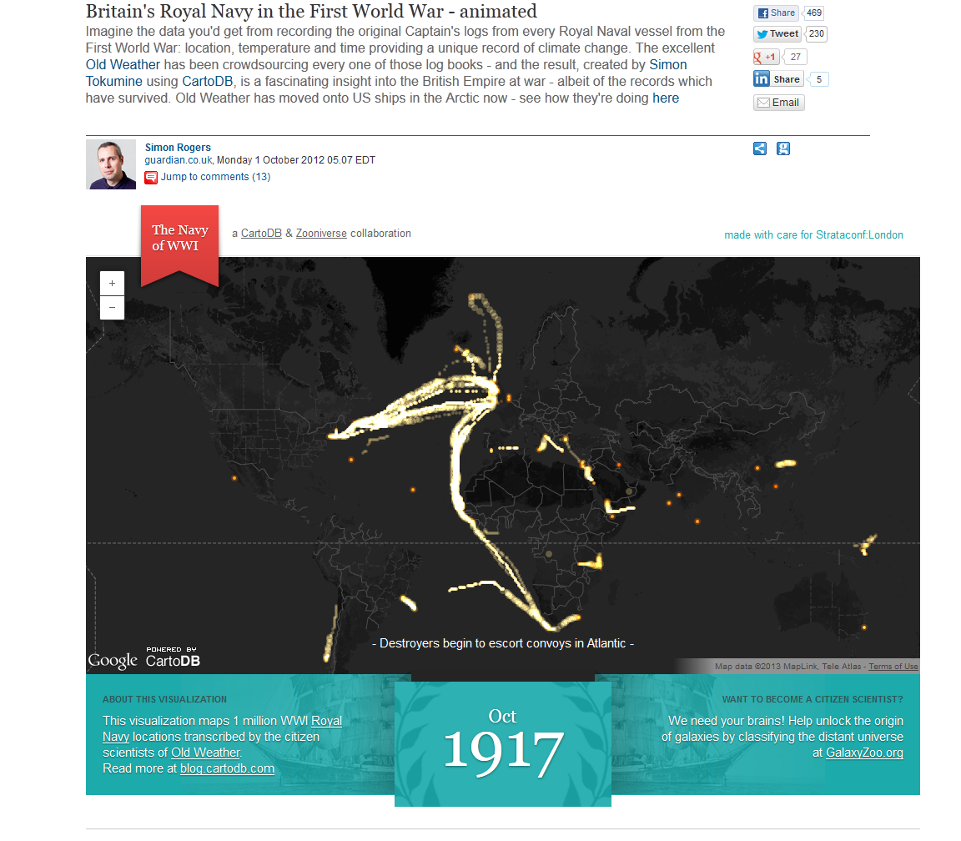
A million positions transcribed

Slide 18
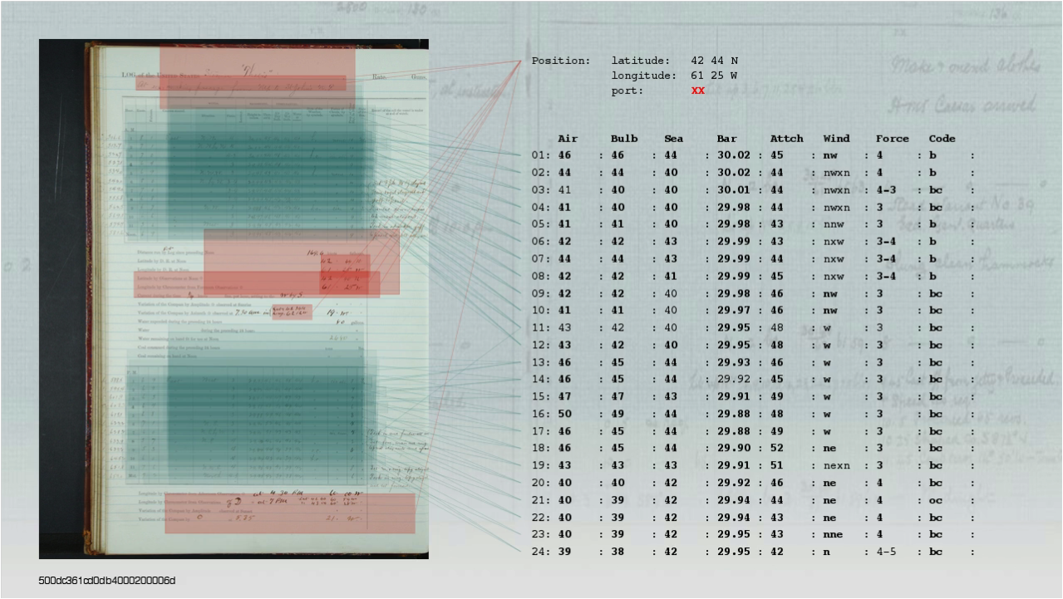
Looks like this:
User interface built by Arfon & Co at ZOONIVERSE

Slide 19
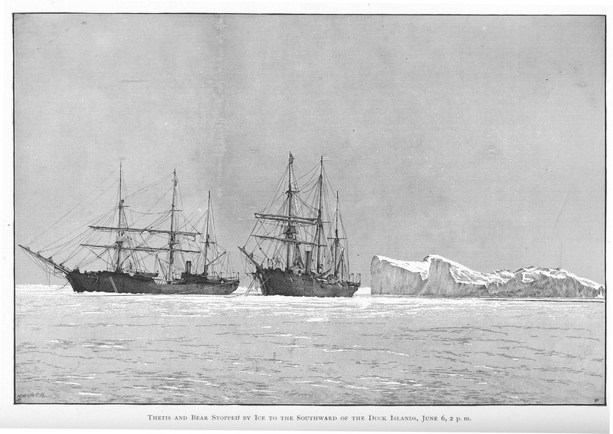
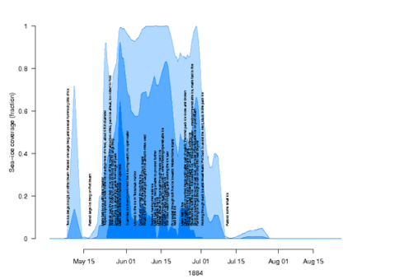
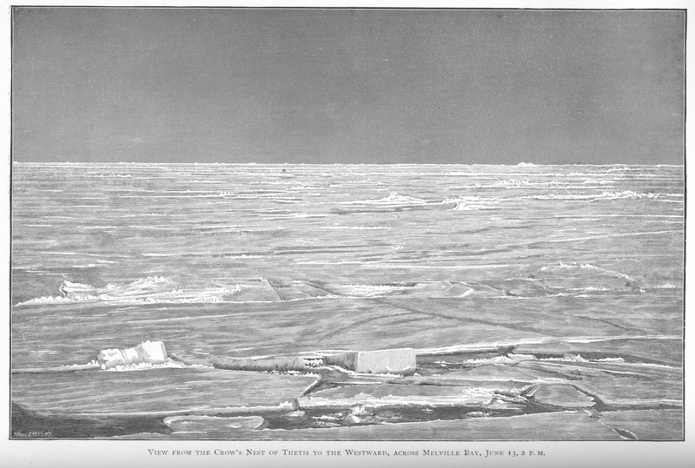
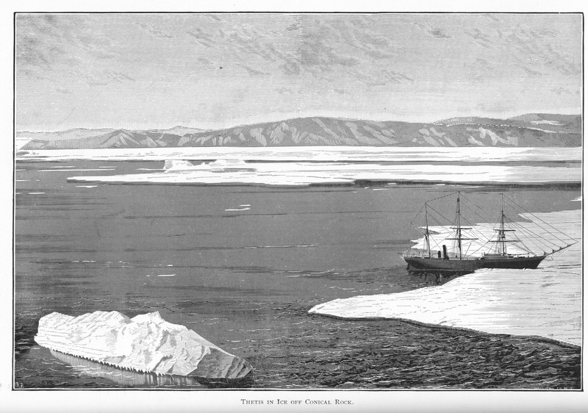
Now with sea ice, too
USS Thetis 1884 ice observations (black text) compared with along-track sea ice coverage from HadISST 1979-2004 (max-mean-min)

Slide 20
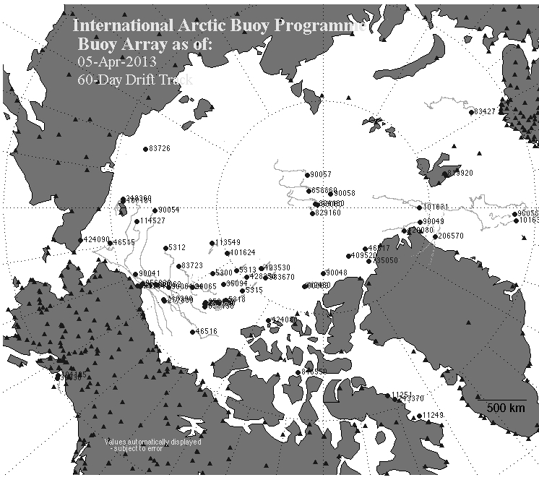
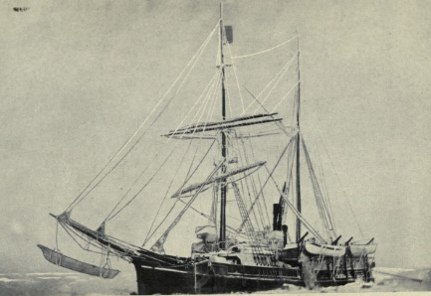
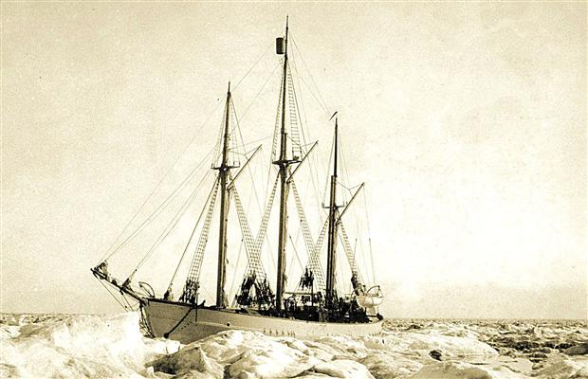
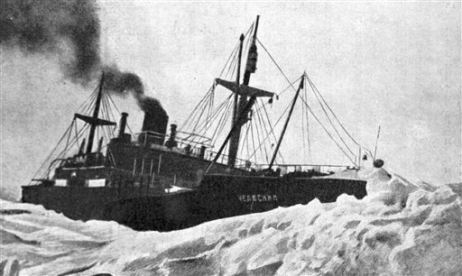
Direct applications
Jeannette (1879-1881)
Karluk (1913-1914)
Sea ice dynamics
inferred from the first-generation of instrumented drifters
Maud (1922-1925)
60–130 years of new (old) sea ice reconnaissance
Chelyuskin (1933-1934)

Slide 21
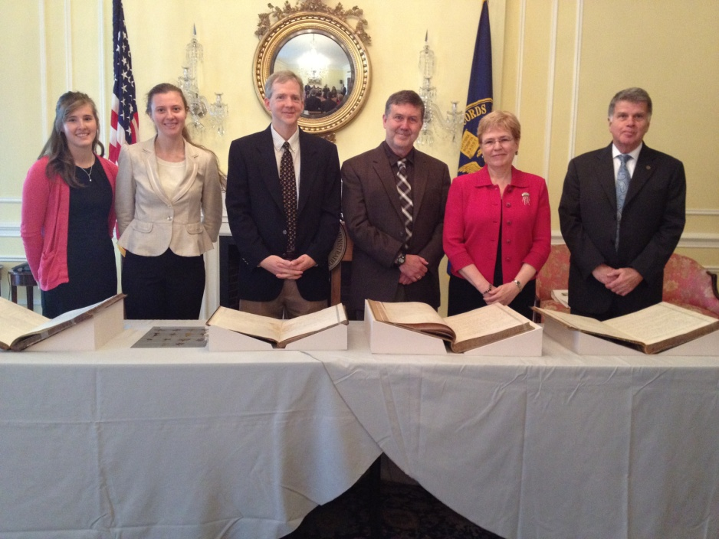
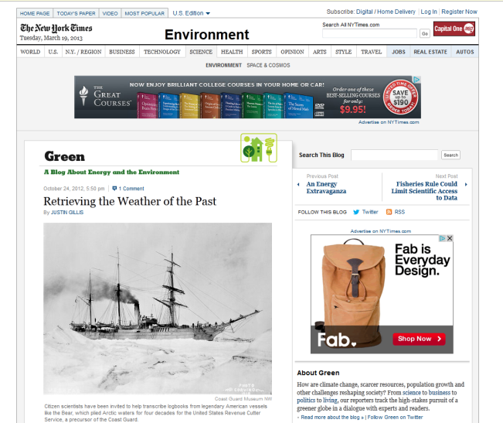
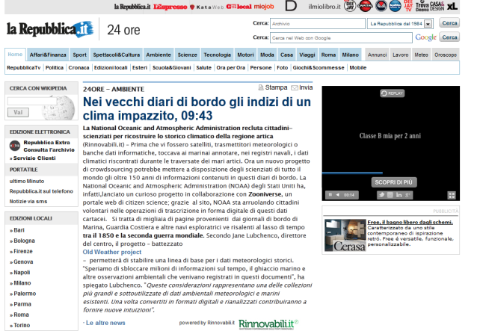
Now hear this!
Ripples
Participation
Elizabeth Milla Mark What a tie! Dr. Lubchenco AOTUS
SPLASH!
Launch of Old Weather – Arctic at the National Archives
25 October 2012
Washington Post Chicago Tribune Western Australia Today Slate Scientific American The Weather Channel ClimateWire Outside Tehran Times SXSW Reuters EOS/AGU CBC Radio North (Yellowknife) The Weather Channel (again) …..

Slide 22
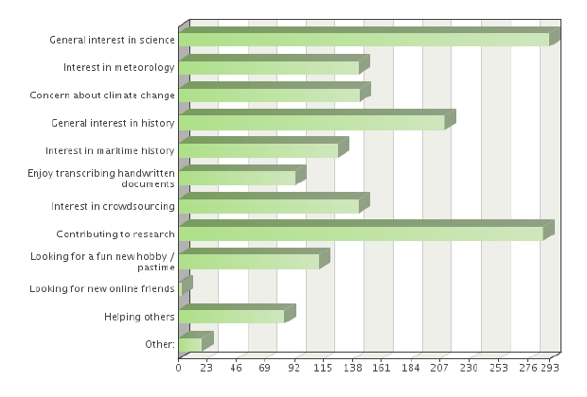
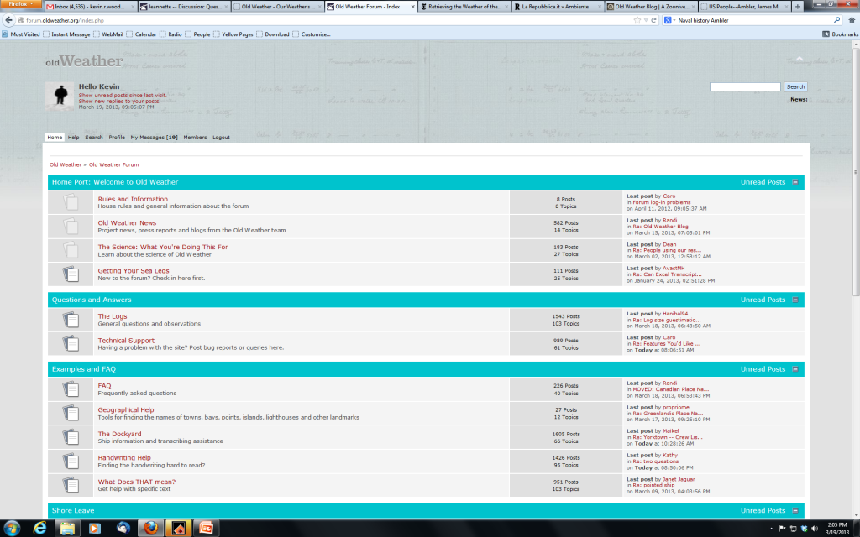
Why do people join & stay?
Survey Says!
Alexandra Eveleigh, UCL Interaction Centre, University College London
The Forum: community, creative space, superior expertise and technical support,
ever-increasing depth...
But really, its the right-hand page…

Slide 23
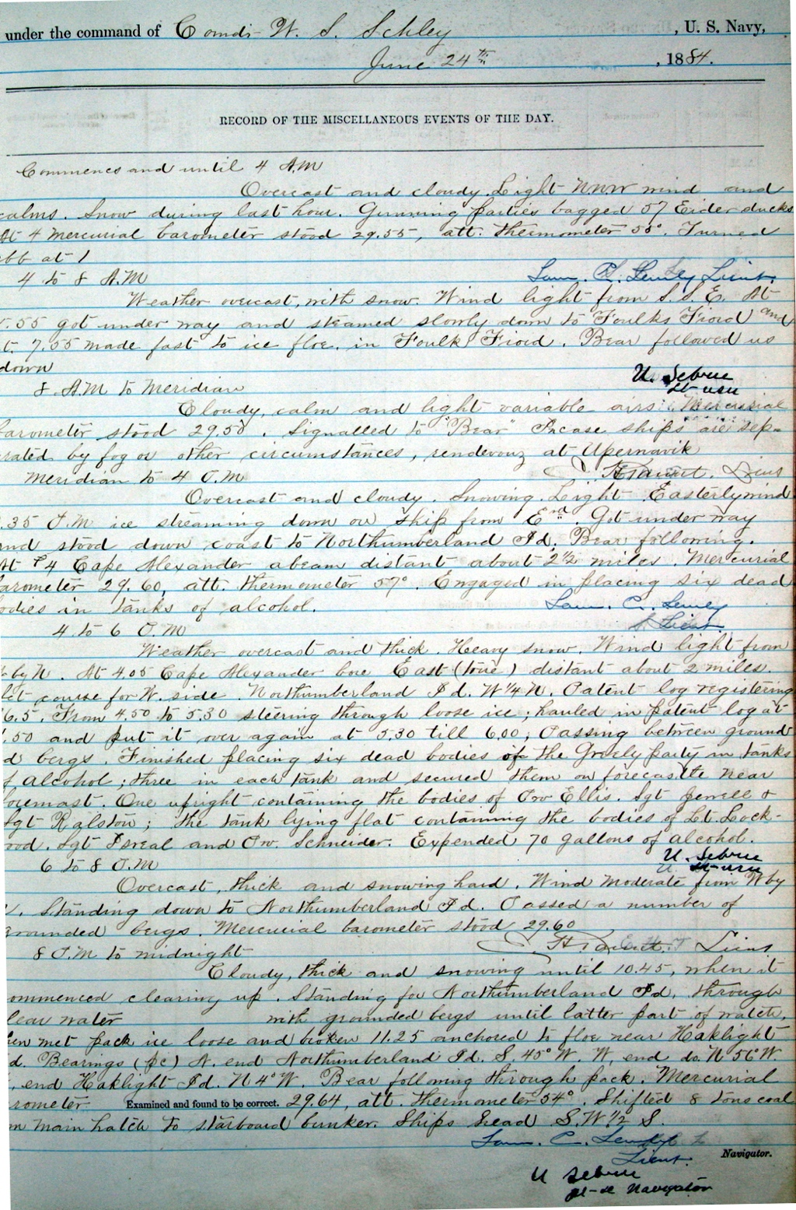
Extraordinary stories
Captain Roald Amundsen came on board as a guest of the captain...typhoon signal spotted on shore...steaming through scattered wreckage in thick fog...ran down the convoy at first light and found three ships missing...engaged in placing six bodies in barrels of alcohol…Natives came
on board bringing a number of articles from the wrecked whaling bark "Vigilant"

Slide 24
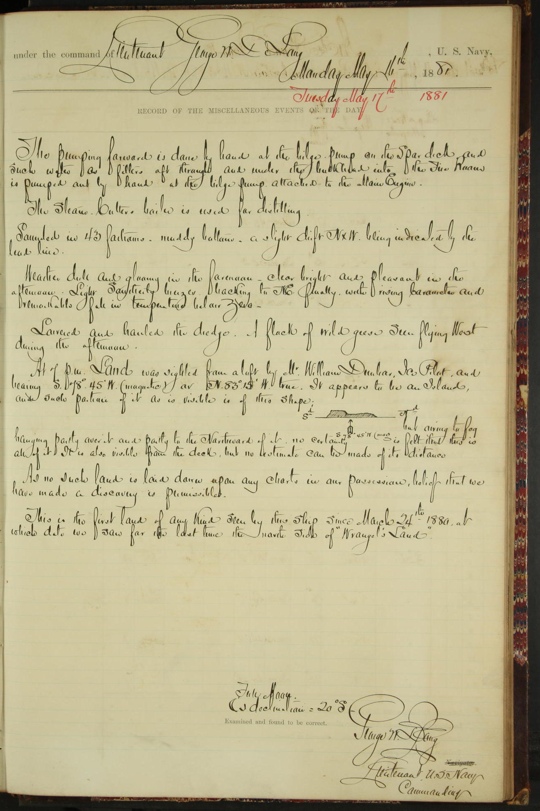
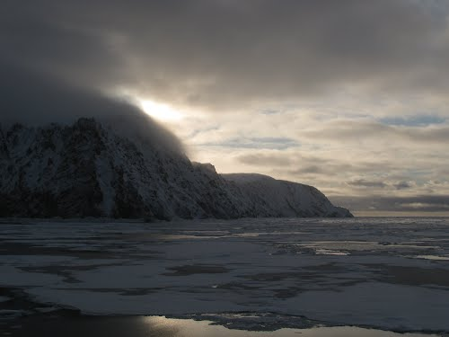
Moments of discovery
Jeannette Island (Ostrov Zhannetty)

Slide 25
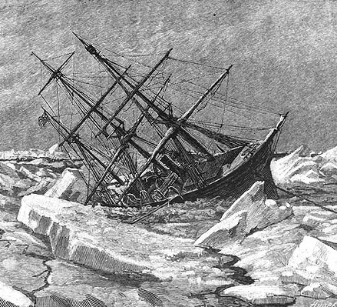
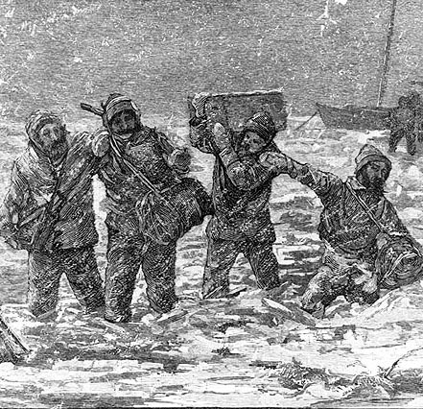
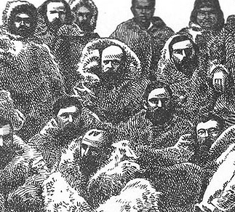
Save the logbooks
Jeannette crushed
Melville’s party
De Long’s men carry the logbooks ashore through a mile of broken ice

Slide 26

Ashore was not enough
…Bubokoff and Kolinkin hoisted the box containing the precious books and records of the expedition into the top of a high tree, lashing it fast; but the water continuing to rise they became frightened and raised and lashed it still higher, when Kolinkin fell from the tree and was borne away by the current into the branches of another, where he remained without food for several days.
G. Melville (Ch. Engineer of the Jeannette) – In the Lena Delta
Today

Slide 27



More stuff turns up
Surgeon’s weather log supplied by the US Navy Bureau of Medicine Archive after public release of Old Weather – Arctic & photographed at the National Archives by project staff
James M.M. Ambler, USN
(1848-1881)

Slide 28


Extraordinary value-added
Old Weather citizen-scientists produce their own research and project reference material (handwriting help, technical terms, place names, etc)
Could not be done with a top-down approach
Currently recorded: natural phenomenon, crew lists, burials at sea, discipline & desertion, ships met, notable events of all kinds…
The bonus: word- date- position-searchable manuscript & metadata

Slide 29


Other uses unimagined…
Old (Space) Weather
At 1 A.M. faint aurora chiefly in NE and W.N.W. Lunar circle. At 2 a.m. very faint auroral patches. At 3 faint auroral glimmers in W.N.W. The Sun was raised by refraction above the horizon before 6 a.m. At 11 P.M. broken curtain arches 10º and 20º in altitude to N.E. extending from E to N. An exceptionally beautiful auroral display commenced shortly before midnight. From W x S to N.E. and chiefly South of zenith, from 10º to 15º in alt. an auroral band extended in a Series of flat Semi-elliptical curves opening to the N?d. On the inner or North edge of the band it was brilliantly white, while the light faded down toward the Southern horizon to a pale cloud-like intensity, in which faint lines would occasionally show. To the North of zenith very meager bands of long streamers hung across the Sky. A peculiarity of the display was the regularity with which the curves, which were moving slowly along the band from W to E broke into rapid and distorting undulations when they aimed at a point lying within the space apparently occupied by the Constellation Ursa Major.

Slide 30



Arctic Rediscovery Project
www.pmel.noaa.gov/arctic/rediscover

Slide 31

A Look Back
Photograph and moving picture collection
Connect with people – scientifically interesting – historical value
USRC Corwin
Crew of the Bear
Hallie Portz’s capstone project poster (UW iSchool)
Photographer aloft
on Northland

Slide 32


Sea Ice of the Old Arctic
Sea ice maps re-published online as a downloadable data set by NSIDC
280 maps over 56 yrs
(1893-1939 and 1946-1956)
More value-added to come

Slide 33


Student Projects
Commack High School (New York)
You can do one too!
V. Underhill, JISAO undergraduate research internship

Slide 34

U.S. National Archives
www.archives.gov/citizen-archivist/

Slide 35

Expected Outcome
BIG INFUSION OF (NEW) CLIMATE DATA
WEATHER – OCEAN – SEA ICE – ECOSYSTEM
FUELS EXTENDED REANALYSIS PROJECTS
BETTER ENVIRONMENTAL PREDICTION
MASSIVELY ENHANCED ACCESS
TO ORIGINAL DOCUMENTS OF NATIONAL SIGNIFICANCE

Slide 36

Currently…

Slide 37

(129 years later)
The scientific value of the work accomplished by these men, living and dead, can only be estimated after their observations have been compiled and computed, compared and applied - all of which will involve years of patient toil.
George W. Melville
(1841-1912)
oldweather.org

