Slide 1
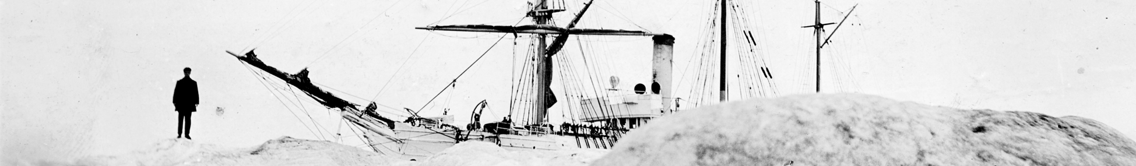
ARCTIC REDISCOVERY PROJECT
Providing access to heritage data resources for climate and ecosystem research
Kevin R. Wood¹, M. Mollan², P. Brohan³, and N. N. Soreide⁴
¹University of Washington
²U.S. National Archives and Records Administration
³UK Met Office Hadley Center
⁴NOAA Pacific Marine Environmental Laboratory
Notes:
Thetis in the ice
http://en.wikipedia.org/wiki/USS_Thetis_%281881%29
Logbook from Tetis (found Greely expedition)
The Bear
The first USS Thetis was a three-masted, wooden-hulled steam whaler in the United States Navy used to rescue a polar expedition (the Greely expedition) and later in the Revenue Cutter Service.
The Bear was a dual steam-powered and sailing ship built with six inch (15.2 cm) thick sides which had a long life in various cold-water and ice-filled environs. She was a forerunner of modern icebreakers and had an exceptionally diverse service life. According to the United States Coast Guard official website, the Bear is described as "probably the most famous ship in the history of the Coast Guard.“ Also participated in rescuing the Greely expedition.
Greely expedition (1881-1884) purpose was threefold: to establish a meteorological-observation station as part of the First International Polar Year, to collect astronomical data, and polar magnetic data. During the expedition, two members of the crew reached a new "Farthest North" record.

Slide 2
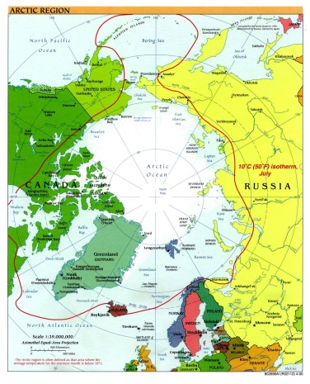
Need for historical climate data
Modern climate science is built on recovered historical data
Climate issues – such as the unexpectedly rapid loss of Arctic sea ice - need to be understood in a longer context of time
Much of our historical climate data is from land-based weather observations going back to 1700’s
Satellite data, covering the ocean and polar region, dates back to 1979
Climate science would benefit greatly by the
addition of historical observations of the ocean.
Ship logs are the only sources of weather data for
some locations and times
Notes:
Modern climate science is built on recovered historical data
Climate issues - such as the unexpectedly rapid loss of Arctic sea ice - need to be understood in a longer context of time
Much of our historical climate data is from land-based weather observations going back to 1700’s
Satellite data covering the ocean and polar region dates back to 1979.
Climate science would benefit greatly by the addition of historical observations on the ocean.
Much of the Arctic is covered by ocean

Slide 3
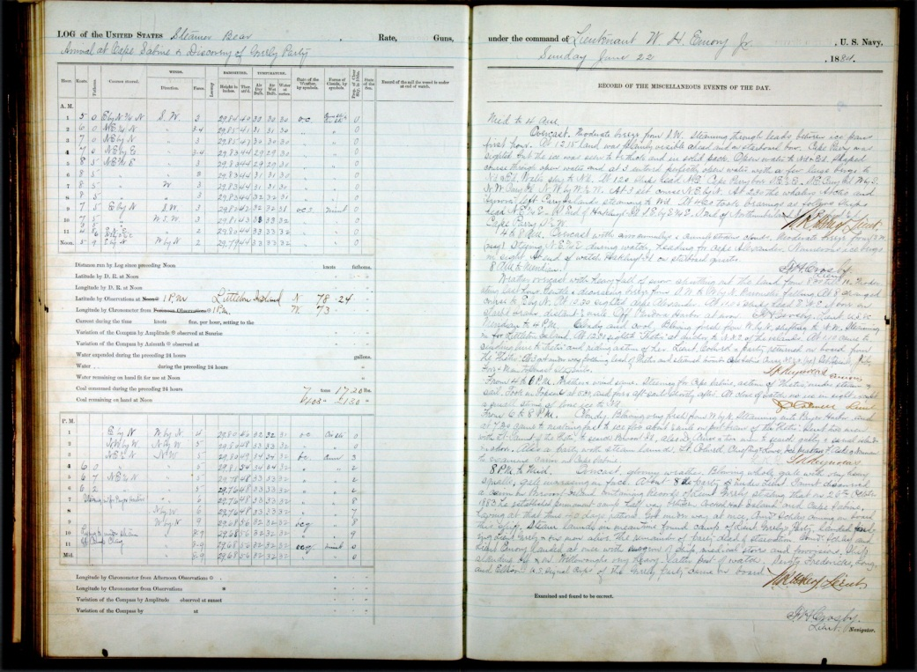
New-to-science data
Observations were meticulously and scientifically collected and recorded
Preserved in hand-written ship logbooks and other original documents
  U.S. National Archives and Records Administration (NARA)
  Examples of other sources
    Nicholson Whaling Collection at the Providence Public Library
    New Bedford Whaling Museum via Digital Commonwealth
Observations represent one of the largest and most underutilized collections of meteorological and marine environmental data in existence

Slide 4
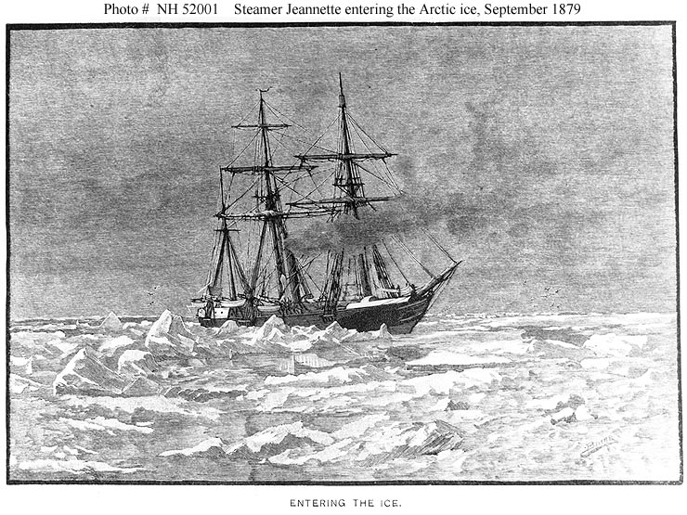
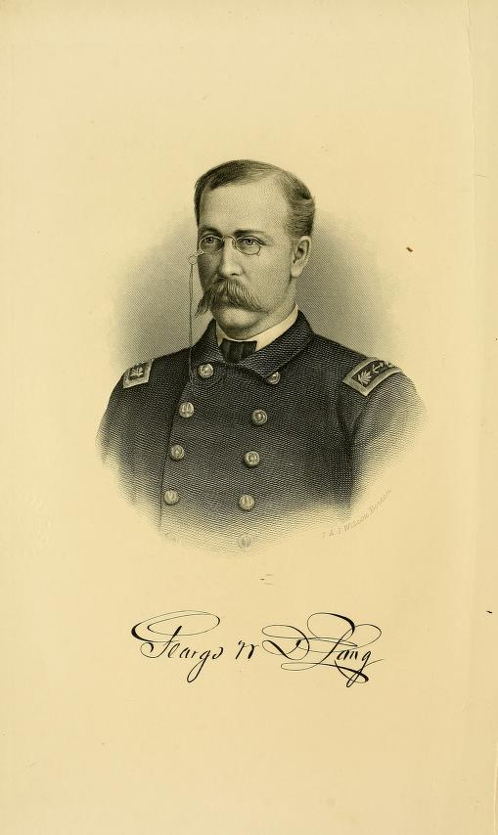
Steamer Jeanette
Notes:
Log Period and Areas of Service - 1879-81 (imaged - June 1879-June 1881), Arctic Exploring Expedition under George Washington DeLong. She sailed with 30 officers and men (28 in some sources) and 3 civilians, as a privately-owned ship on a Polar Expedition but under US Navy orders.
The Jeanette was a steam barque or bark, ex-British Philomel-class wooden gunvessel Pandora, built by Pembroke Dockyard, laid down 30 March 1860, launched 7 February 1861, commissioned September 1861, 570 long tons, 145ft long x 24ft 4in beam x 13ft draft, 8-11kts, originally 60 crew.
Sold in 1875 to Sir Allan Young for Arctic exploration, then in 1878 to James G Bennett of the NY Herald and renamed Jeannette. Bennett obtained US Government help to fit her out for a Polar Expedition. She sailed with 30 officers and men (28 in some sources) and 3 civilians, as a privately-owned ship but under US Navy orders.

Slide 5
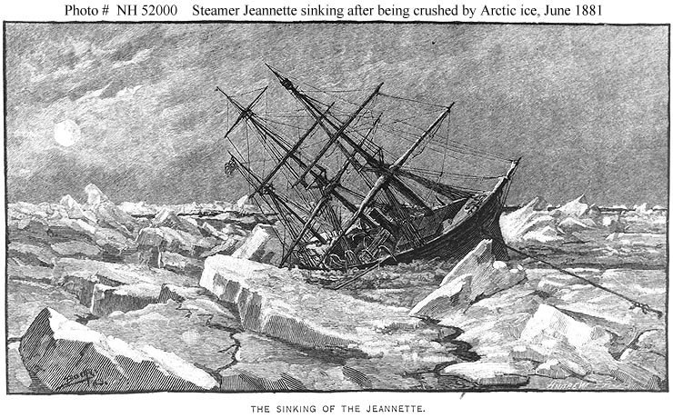
Steamer Jeanette
Crushed by ice flows north of Siberia, 12 June 1881.
Sank next morning in 77º 14N, 154º 58E.
Notes:
12 June 1881 - Ice started to crush the ship. The crew unloaded equipment and supplies and next morning she sank. DeLong and his men then started hauling their three supply-filled boats over the ice towards the Lena River Delta. ........ The story continues in outline in the woodcuts below.

Slide 6
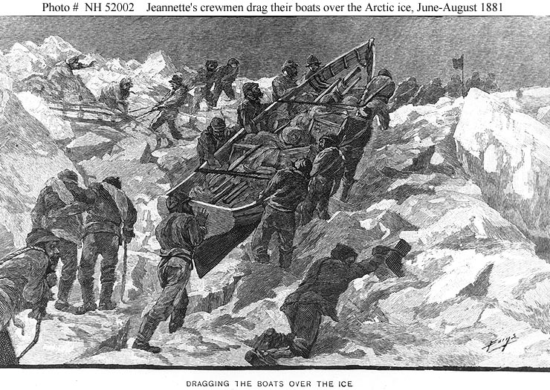
Steamer Jeanette
Notes:
12 June 1881 - Ice started to crush the ship. The crew unloaded equipment and supplies and next morning she sank. DeLong and his men then started hauling their three supply-filled boats over the ice towards the Lena River Delta. ........ The story continues in outline in the woodcuts below.
Hauling the three ship's boats over the tumbled ice north of Siberia, June-August 1881

Slide 7
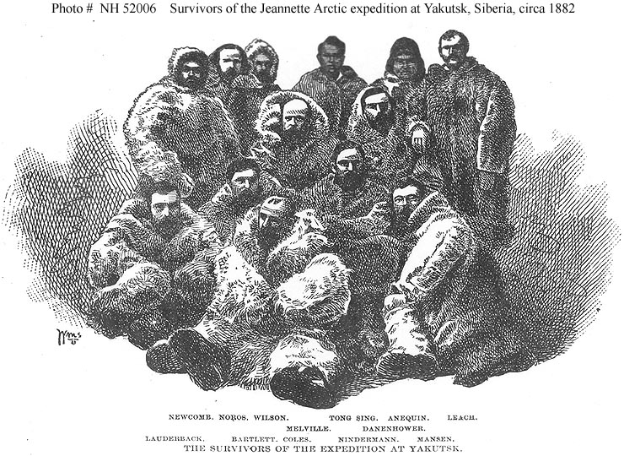
Steamer Jeanette
Notes:
The 13 survivors, at Yakutsk, Siberia, in 1882 - all of Melville's party and the two seaman from LCDR De Long's

Slide 8
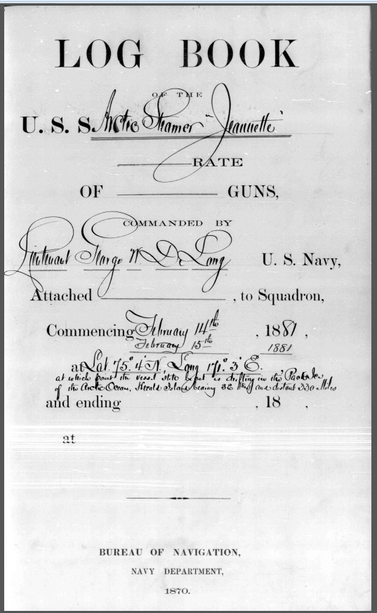
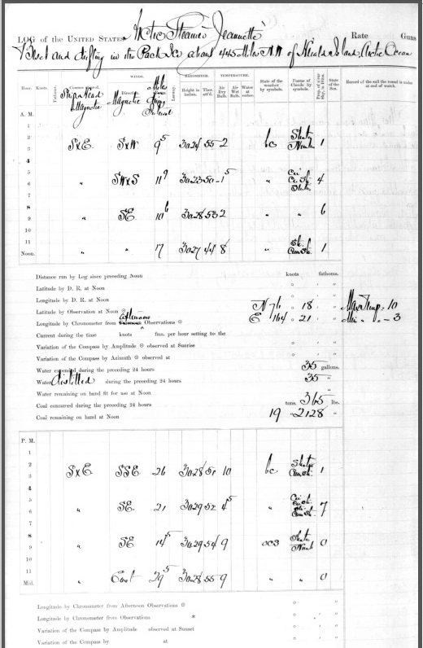

Slide 9
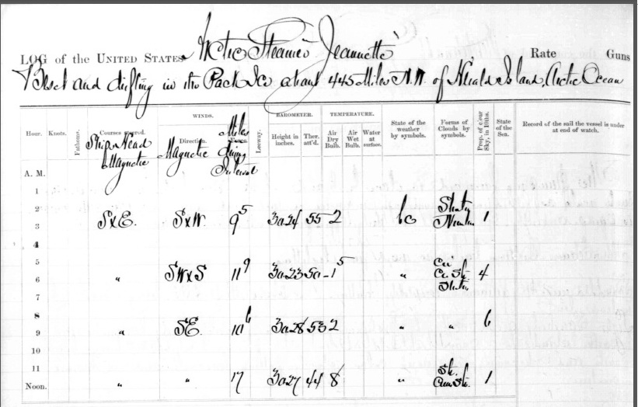
Steamer Jeanette
Notes:
12 June 1881 - Ice started to crush the ship. The crew unloaded equipment and supplies and next morning she sank. DeLong and his men then started hauling their three supply-filled boats over the ice towards the Lena River Delta. ........ The story continues in outline in the woodcuts below.

Slide 10
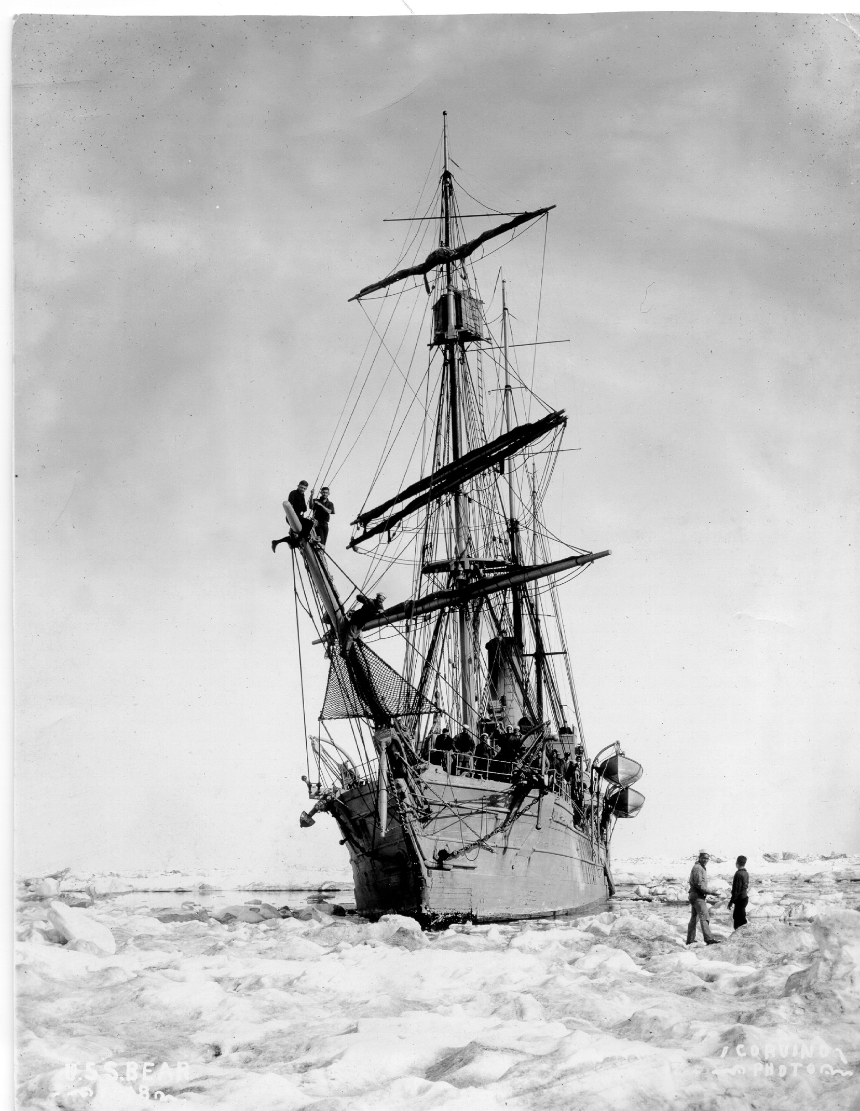
ARCTIC REDISCOVERY PROJECT
Logbooks from Arctic ships
Mid-1800’s to early 1900’s
US Navy, Coast Guard and Revenue Cutters, Coast Survey, Whaling ships
Example
U.S. Navy logbook (1884)
USS Bear in the ice (possibly 1898)

Slide 11
ARCTIC REDISCOVERY PROJECT
This project provides access to heritage data through collaboration between:
  NOAA
  U.S. National Archive and Records Administration (NARA)
  and thousands of citizen volunteers participating in the Old Weather project.

Slide 12
ARCTIC REDISCOVERY PROJECT
Heritage resources identified
At the National Archive, archivists and preservationists
  Provide expert guidance on the logbook holdings of the Archives,
  Train student interns in document preservation and digital imaging,
  Lead the online publication of selected vessel logbooks
    An important resource for understanding the history of Alaska and the Arctic that will be accessible to all
    Original documents will be viewable on the National Archives website

Slide 13
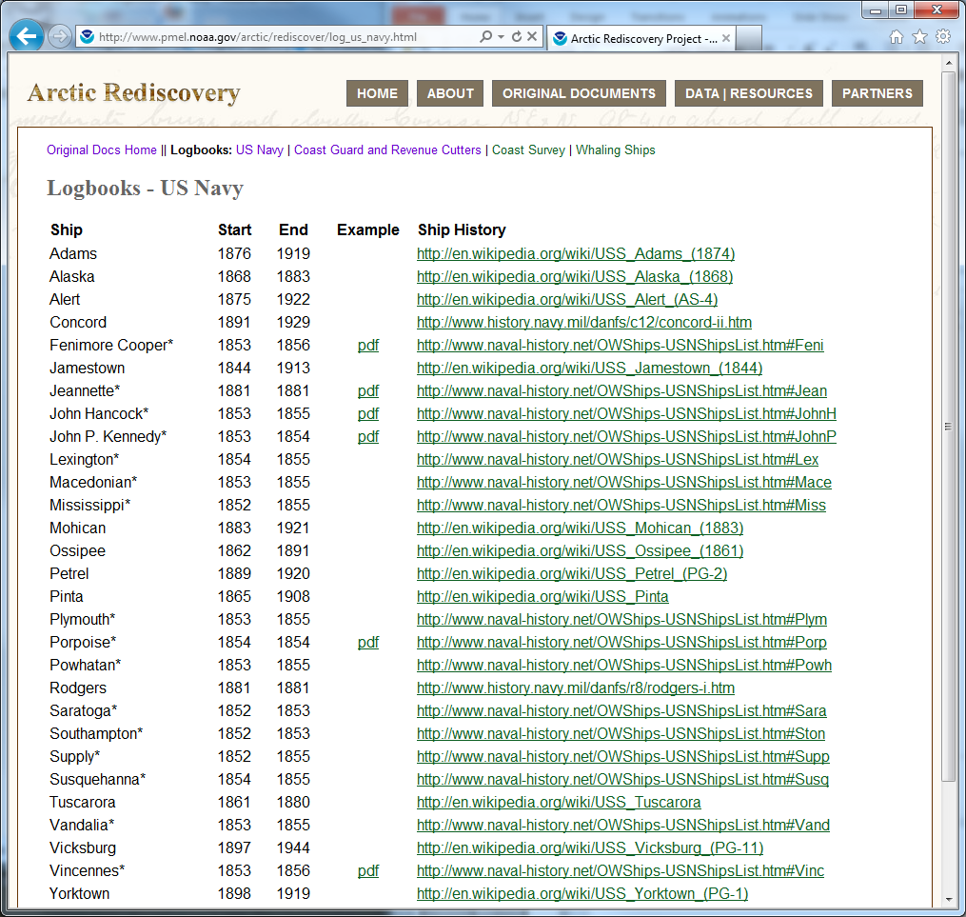
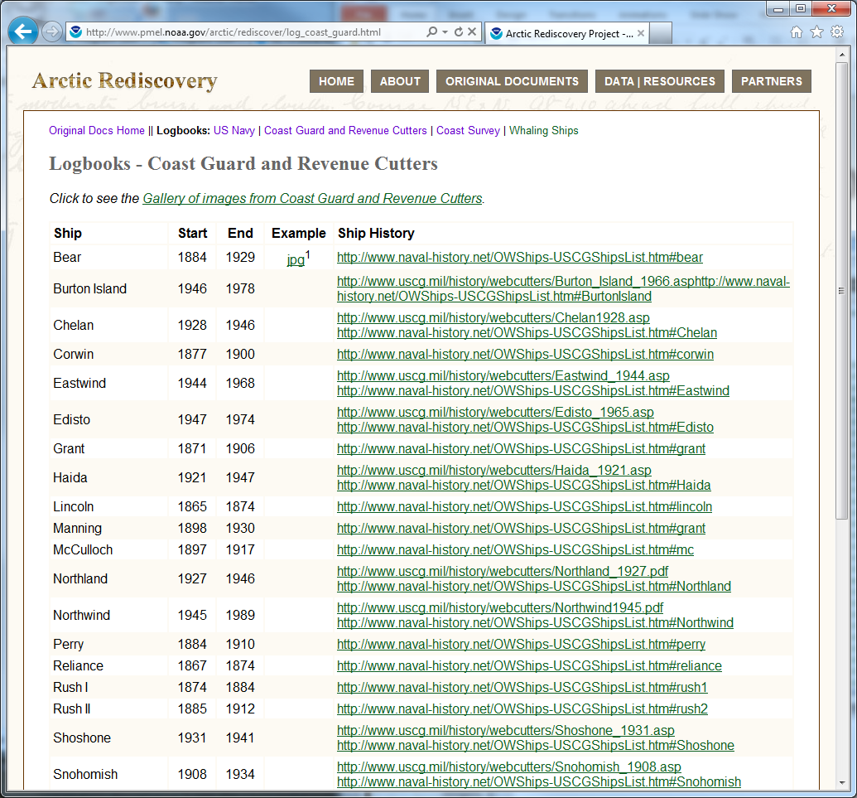
Heritage resources identified
ARCTIC REDISCOVERY PROJECT

Slide 14
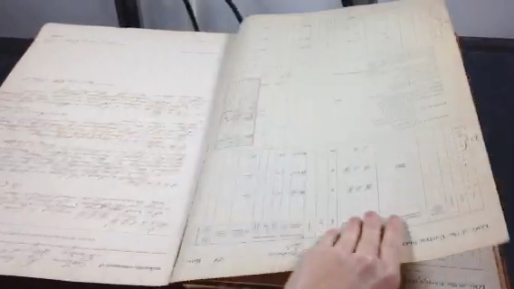
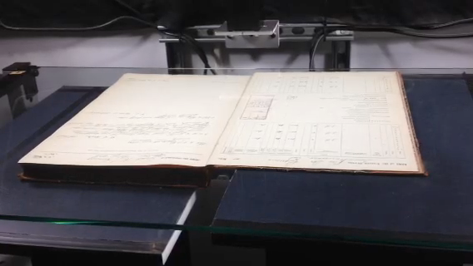
Digital imaging
ARCTIC REDISCOVERY PROJECT

Slide 15
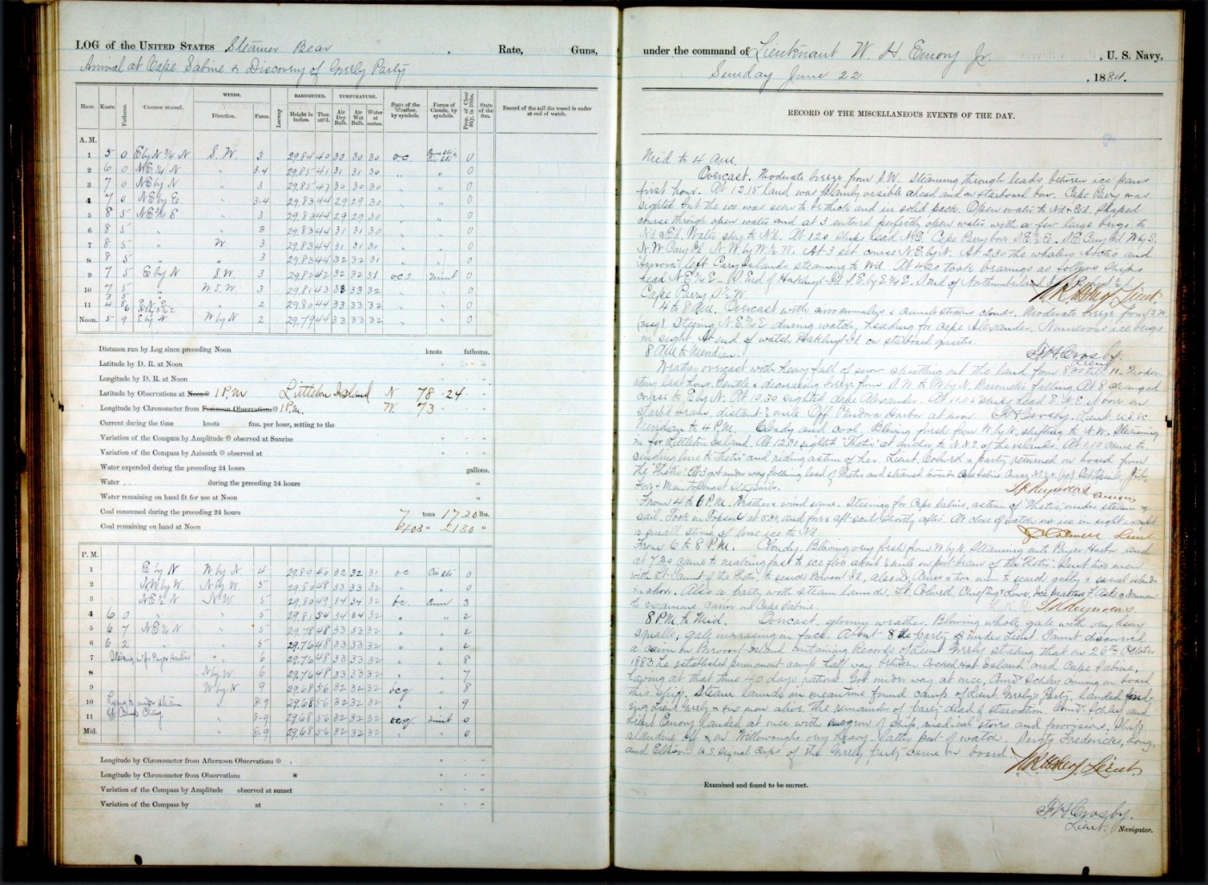
High Resolution Photographs
ARCTIC REDISCOVERY PROJECT
A U.S. Navy logbook (1884)

Slide 16
Old Weather Project
Transcribing the data from high-resolution images of the hand-written logs
CROWDSOURCING
Old Weather
  Produced, maintained and developed by the Citizen Science Alliance, which works with academic and other partners world-wide
  Large community of scientists and citizen volunteers working to recover environmental data from ships logs
  Since 2010, 16,400 citizen volunteers have transcribed 1.6 million weather observations from British Royal Navy logbooks – work that would have taken one person many years to complete
Notes:
fields of pressure, temperature, wind speed, weather, cloudiness, precipitation

Slide 17
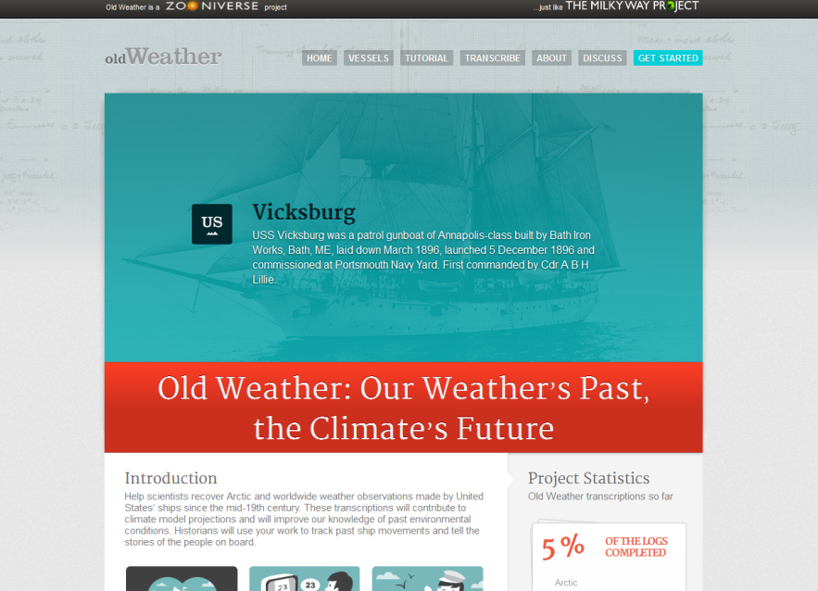
NEW
Old Weather – Arctic
Follow-on from the original Old Weather using US vessel logbooks (19th to mid-20th century)
Launched on 24 October 2012 with a joint press event hosted by the US National Archives in Washington, D.C.
Starting with ~100,000 log book pages
Including an estimated one million new-to-science observations
User interface to accommodate multiple and more detailed US logbook formats
www.oldweather.org
17

Slide 18
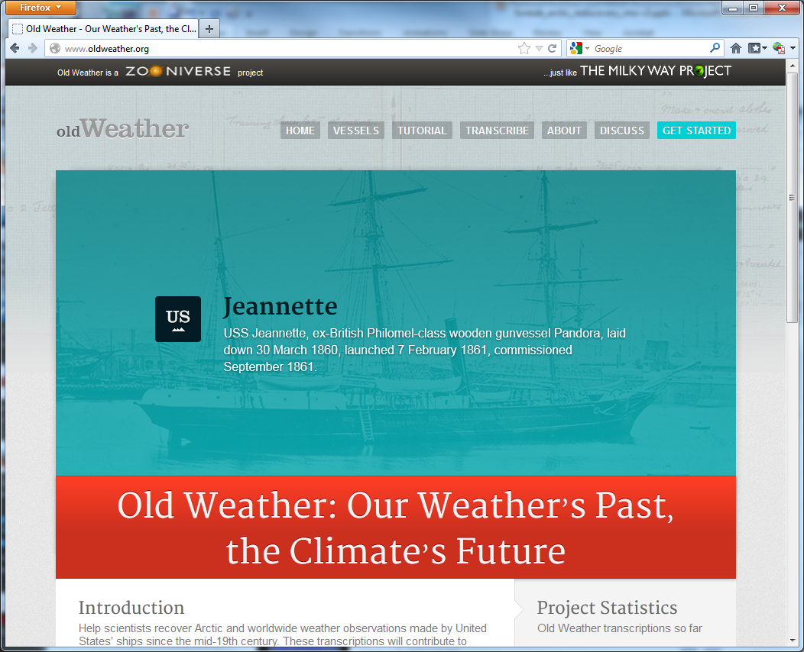
Old Weather-Arctic
www.oldweather.org
sign in, take a tutorial, become a volunteer, and start transcribing

Slide 19
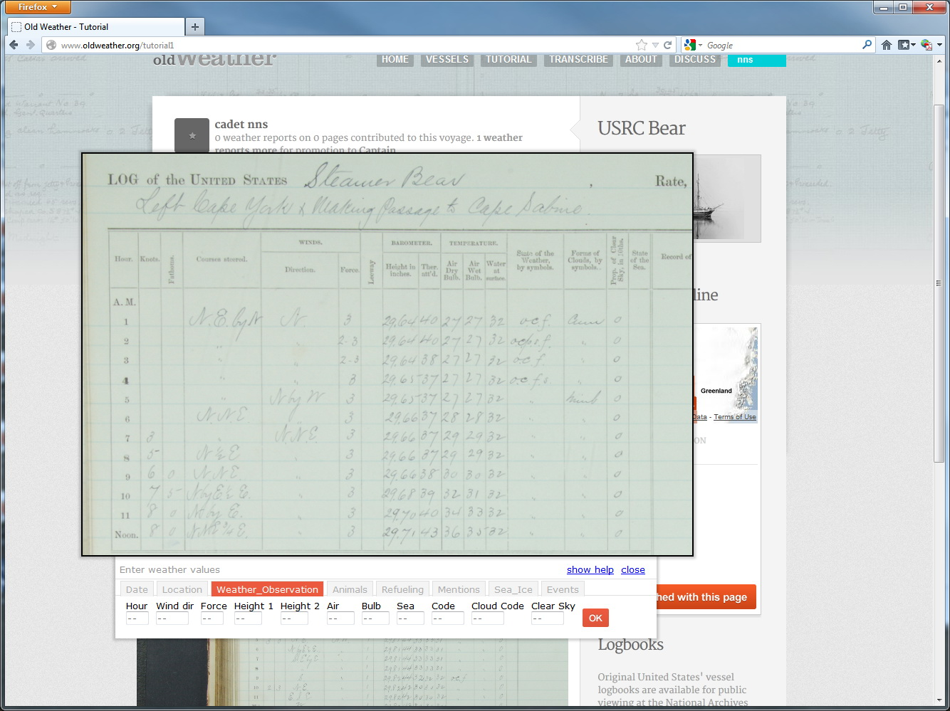
Read the information from the ship log image on the Old Weather website …
… and enter the information into a form
Notes:
several people look at each page and this allows us to correct occasional slips of the keyboard
We will go through the results and clean up obvious mistakes, like large jumps in temperature or a ship that suddenly moves from one end of the E
Previous academic work has shown the reliability of ship's logs in recording weather information, so we can be fairly confident that through Old Weather we're gaining a sensible picture of what the weather really was like.arth to the other, in a later stage of the project.
The climate data will be processed by our team at the Met Office and NOAA and eventually contributed to international databases of historical weather records. These are used to test our computer models of the climate - leading us from the weather's past to understanding the future of the climate.

Slide 20
What happens to the transcribed data?
Quality controlled by the UK Met office and NOAA
Translated into machine readable formats
Incorporated into international databases of historical weather records
  e.g., the International Comprehensive Ocean-Atmosphere Data Set (ICOADS)
Utilized by scientists to help reconstruct the climate of the past and better understand and predict climate today

Slide 21
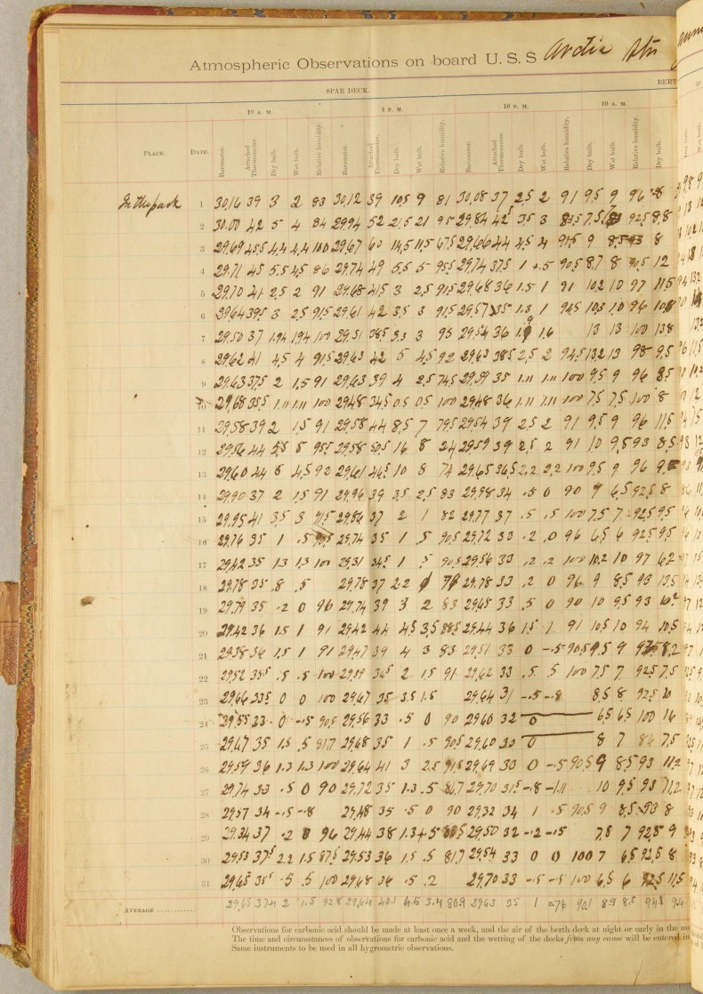
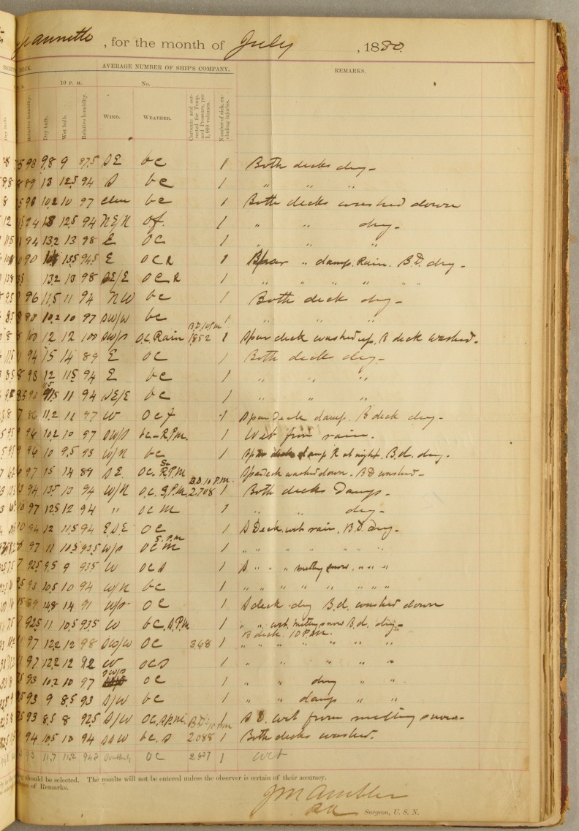
Old Weather
Unexpected contributions
After the public release of Old Weather – Arctic, the surgeon’s weather log from the USS Jeannette was supplied by the US Navy Bureau of Medicine Archive & is being photographed at the National Archives by project staff
Notes:
21

Slide 22
What about other information in the historical documents?
In addition to environmental data a vast quantity of historical information will also be made accessible to researchers and the general public.
After Old Weather transcription, new search and visualization techniques can be applied to this resource that will draw out the stories that connect people of today to the places and people important to their own communities and families in the past.
Original documents will be viewable on the National Archives website.

Slide 23
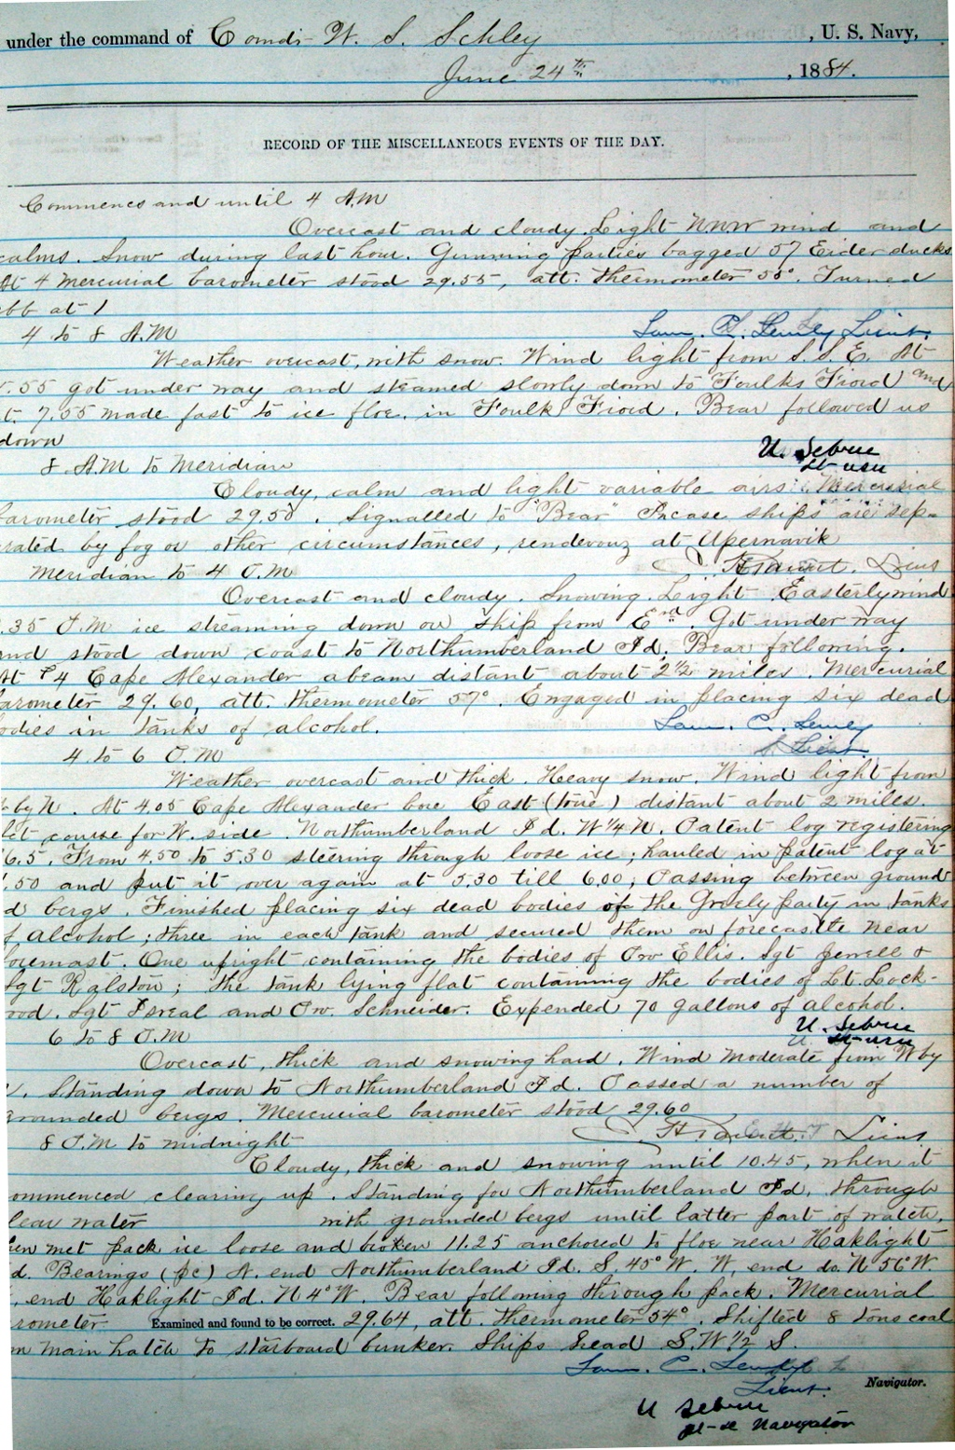
Old Weather
Logs are information rich
Captain Roald Amundsen came on board as a guest of the captain...typhoon signal spotted on shore...steaming through scattered wreckage in thick fog...ran down the convoy at first light and found three ships missing...engaged in placing six bodies in barrels of alcohol…Natives came
on board bringing a number of articles from the wrecked whaling bark "Vigilant"
Notes:
23

Slide 24
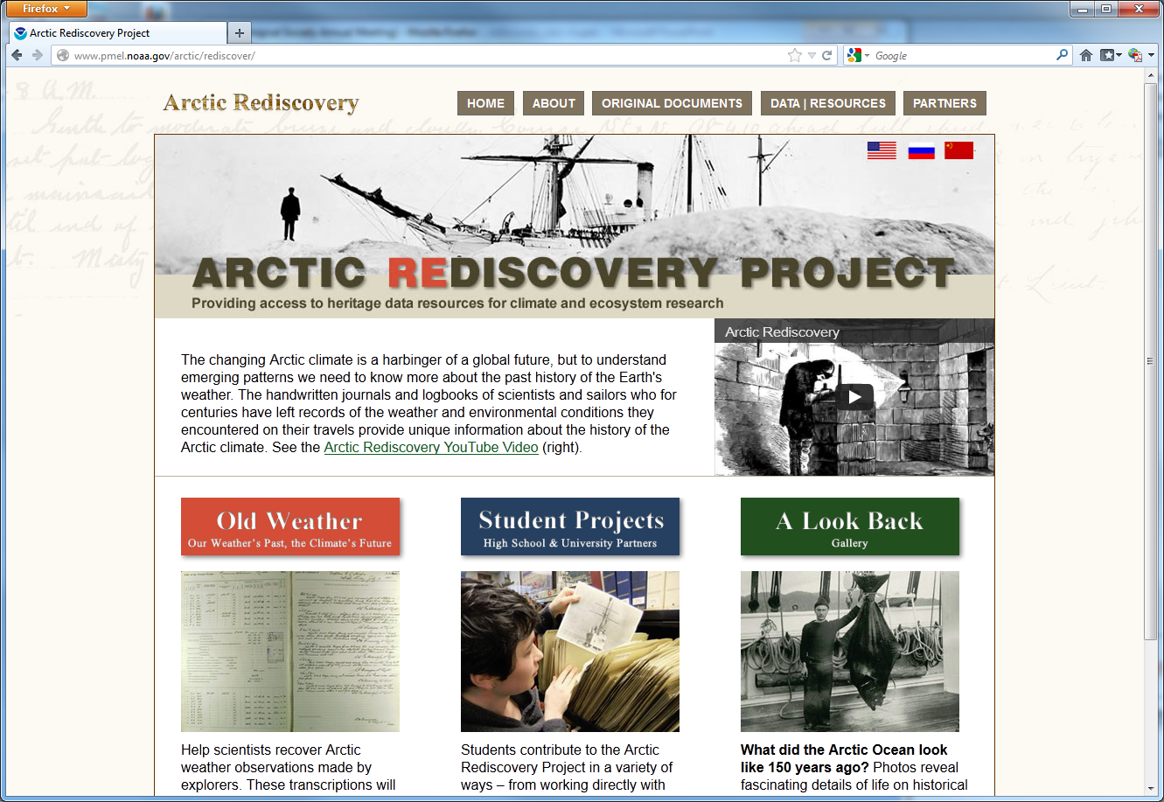
www.pmel.noaa.gov/arctic/rediscover
PROJECT WEBSITE

Slide 25
Backups

Slide 26
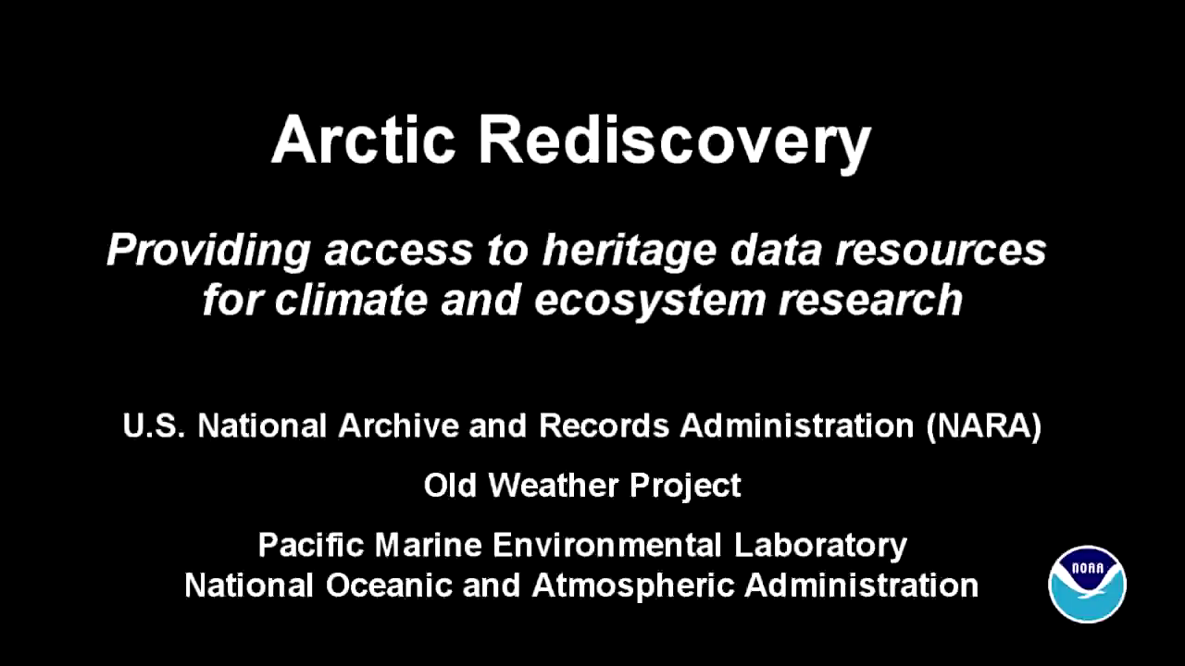
http://youtu.be/vjtX4GJPFRc
Notes:
Video - nprb_v10h.mp4 - must be in same directory as PPT.
Play only 1st minute of video (00:58:31)

Slide 27
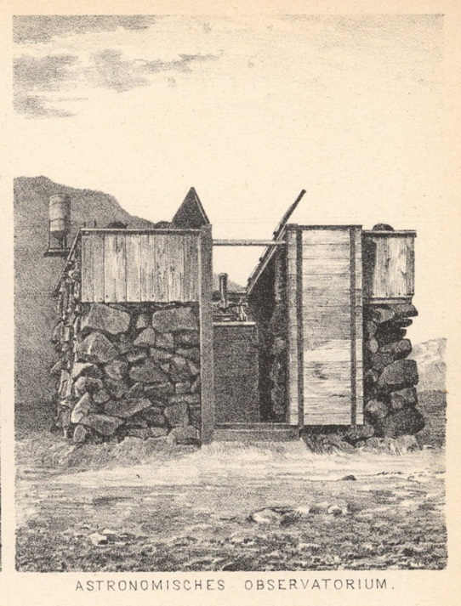
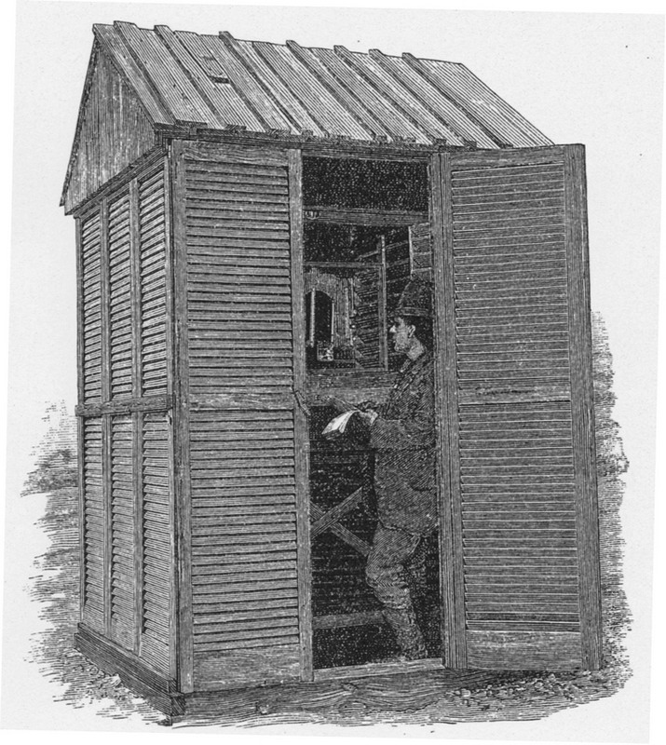
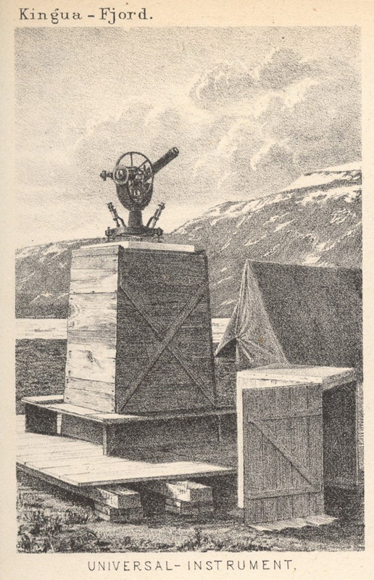
Shore-based observatories established by Arctic explorers
Notes:
Land stations established by early Arctic explorers

Slide 28
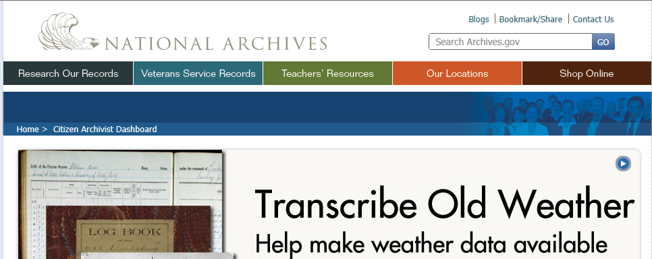
ARCTIC REDISCOVERY
U.S. National Archives
www.archives.gov/citizen-archivist/

Slide 29

Old Weather
16,400 citizen-scientists
Transcribed at least one of 1,090,745 pages

Slide 30
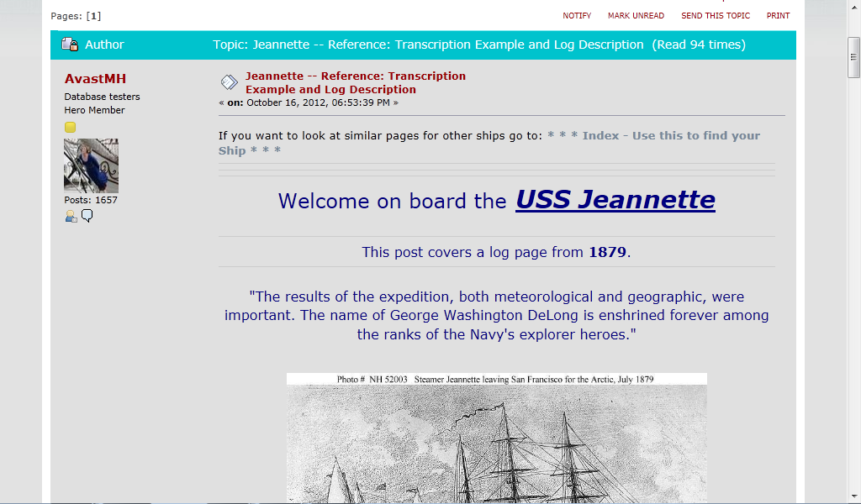
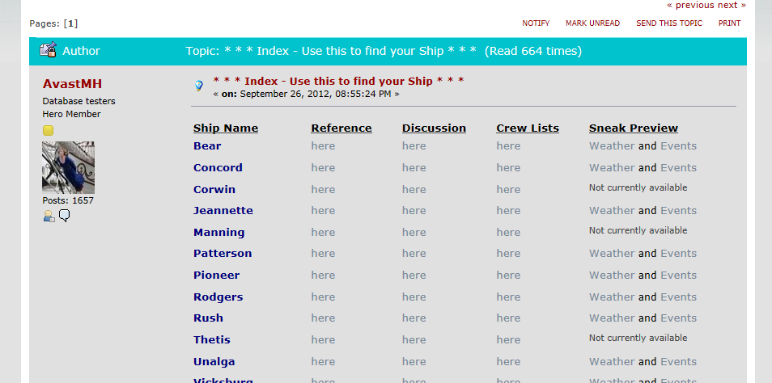
Old Weather
Extraordinary value-added
Citizen-scientists ( -historians & -archivists) produce their own research and project reference material
Could not be done with a top-down approach

Slide 31
Old Weather
Unexpected contributions
Wm. Dall’s notebooks from the Coast Survey schooner Yukon (Smithsonian Institution Archive and Field Book Project)

Slide 32
www.pmel.noaa.gov/arctic/rediscover
PROJECT WEBSITE

Slide 33
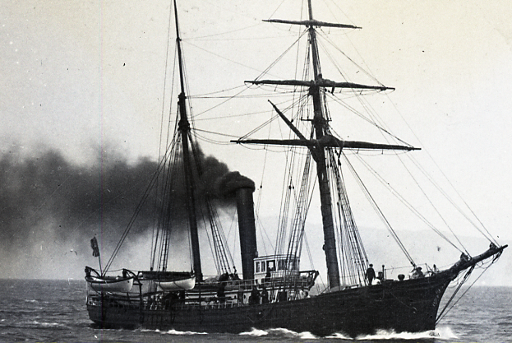
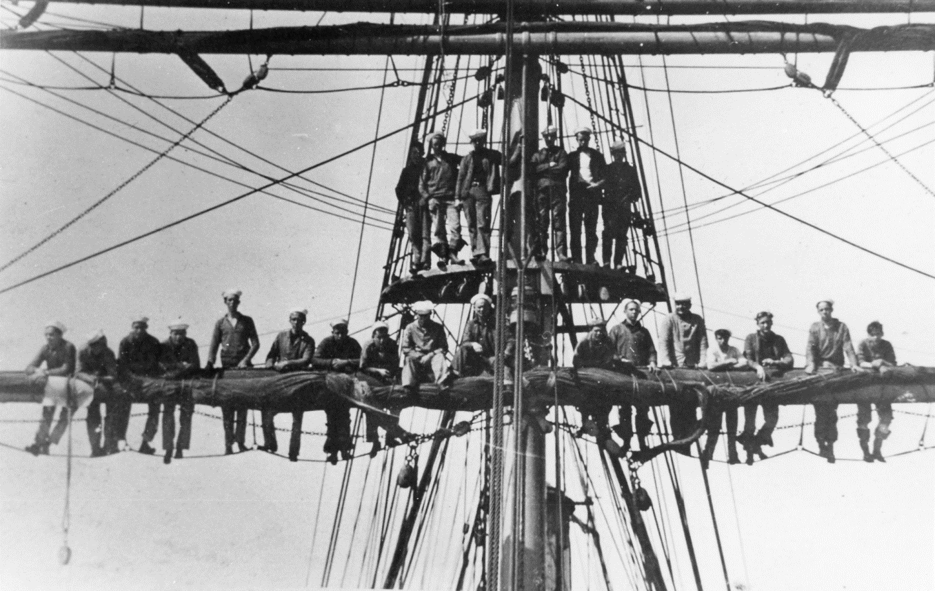
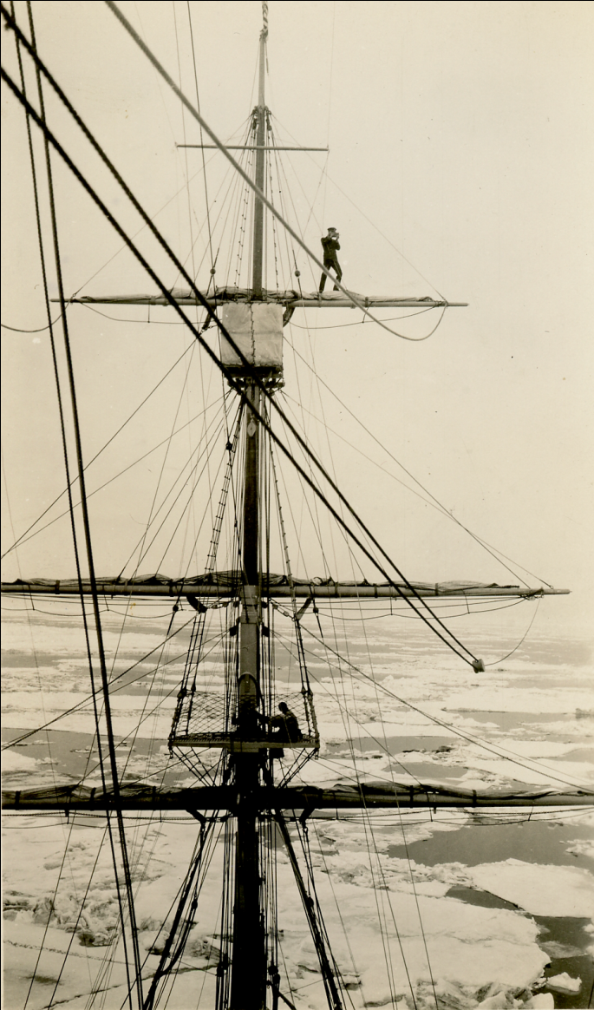
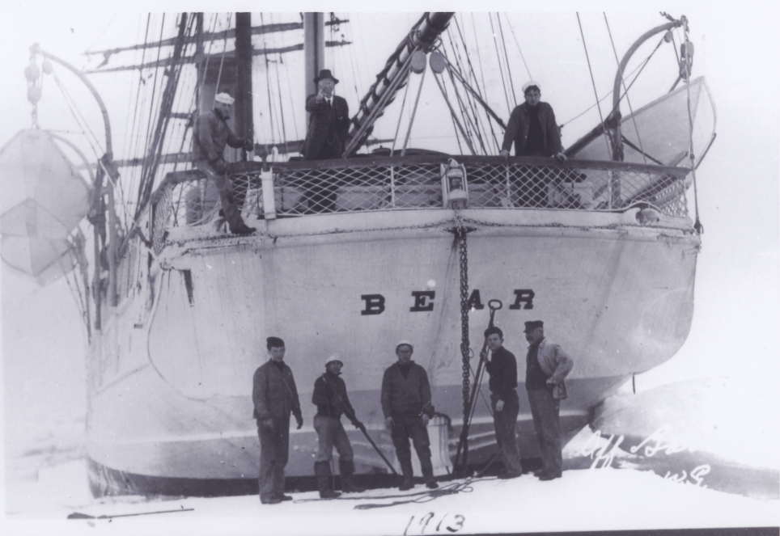
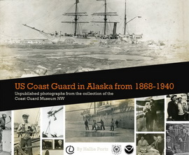
ARCTIC REDISCOVERY
A Look Back
Photograph and moving picture collection
Connect with people – scientifically interesting – historical value
USRC Corwin
Crew of the Bear
Hallie Portz’s capstone project poster (UW iSchool)
Photographer aloft
on Northland

Slide 34
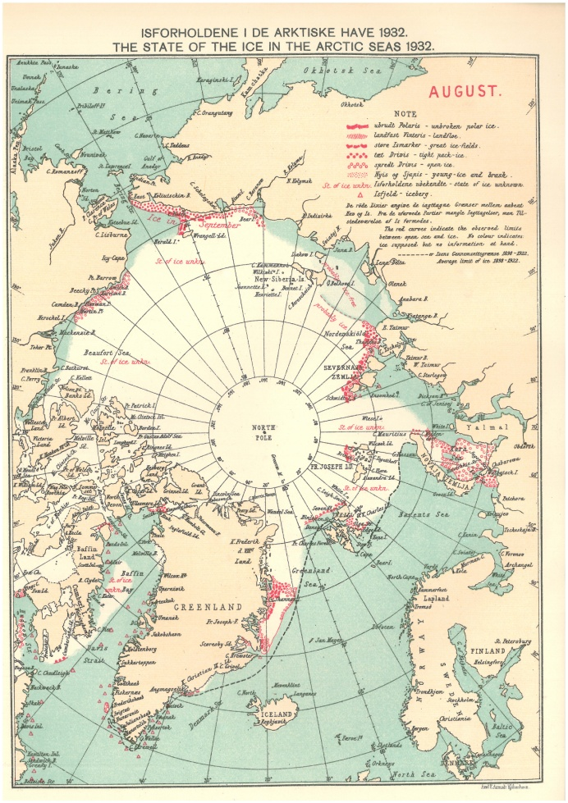
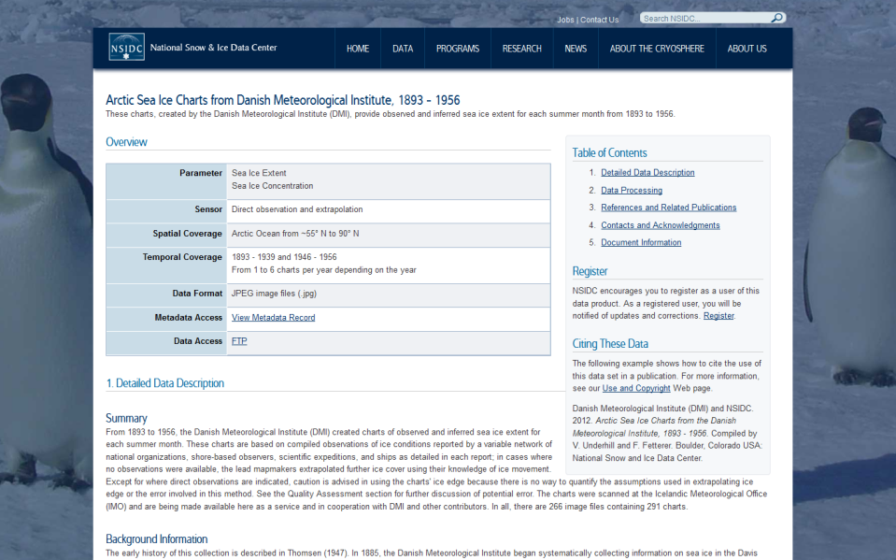
ARCTIC REDISCOVERY
DMI Arctic Sea Ice Maps
Map series 1893 - 1939 and 1946 – 1956 re-published online as a downloadable data set by NSIDC
Other value-added sea ice
products to follow here and
from Old Weather – Arctic

Slide 35
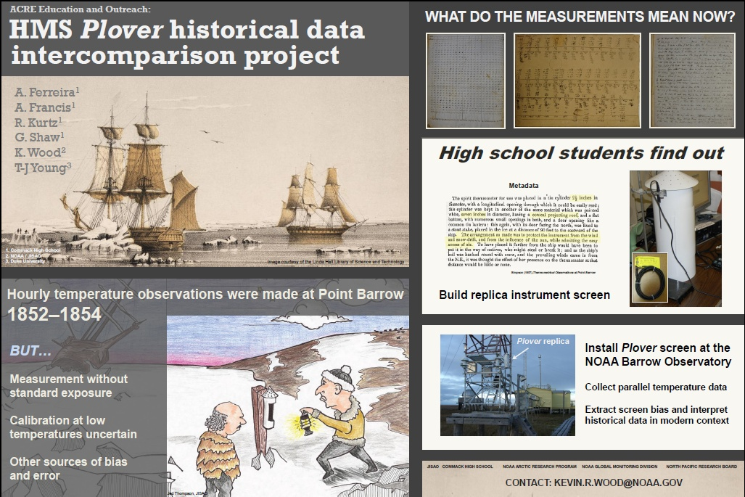
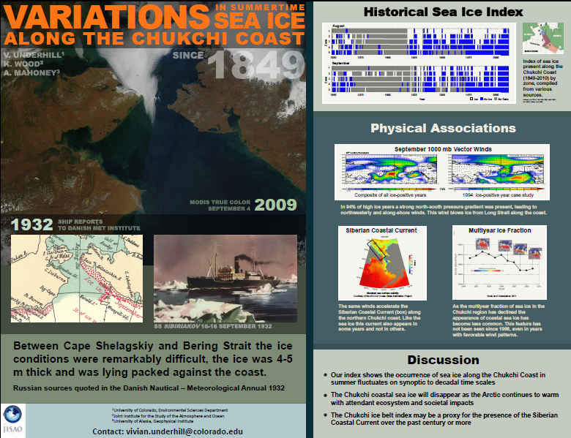
ARCTIC REDISCOVERY
Student Projects
Student posters presented at WCRP Open Science Meeting and Ocean Sciences 2012

Slide 36
ARCTIC REDISCOVERY
CURRENT ACTIVITIES
Project
Custodian / Partner
Funder
Crowdsourcing large-scale
Arctic data recovery (1)
Crowdsourcing large-scale
Arctic data recovery (2)
Online publication of the DMI
‘State of the Ice in the Arctic Seas’ map series
‘A Look Back’ photograph and moving picture collection
Online bibliography
Student projects
US National Archives
Old Weather
US National Archives
Providence Public Library
New Bedford Whaling Museum
Old Weather
National Snow and Ice Data Center (NSIDC)
Iceland Met Office
Danish Met Institute (DMI)
US Coast Guard Museum NW
US National Archives
* * *
Commack HS (New York)
Duke University
NOAA Global Monitoring Div.
Univ. of Washington iSchool
North Pacific Research Board
North Pacific Research Board
National Science Foundation
NOAA@NSIDC
Joint Institute for the Study of the Atmosphere and Ocean
North Pacific Research Board
* * *
Small donations of time, equipment, and machine-shop work

